Slide 1
Integration of snRNA atlases of the adult human midbrain (draft)
By: Chen Ji Rong “Jack” Jiang
Supervisor: Onur Basak

Slide 2
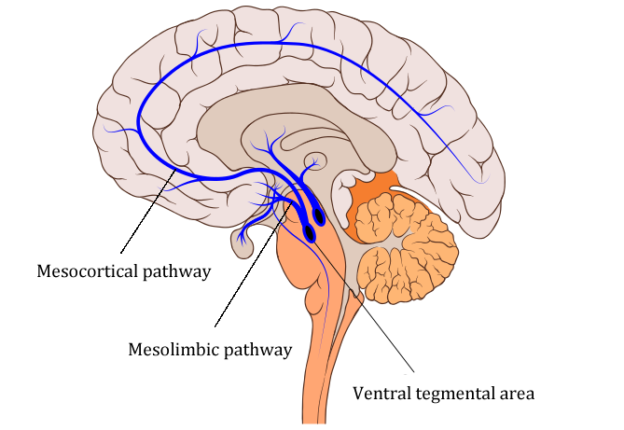
(Ventral) Midbrain
Role in:
Cognition
Reward system
Regulation of emotion, motivation and behavior
Problem: High heterogenity, low sensitivity

Slide 3
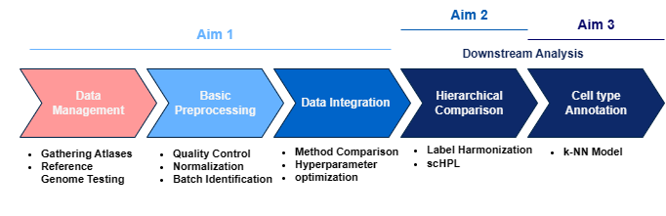
Aims
Integrate multiple atlases into one unified human (ventral) midbrain atlas
Determine hierarchical relations between previously identified cell types by the authors of the atlases
Determine (new) cell types and annotate them

Slide 4
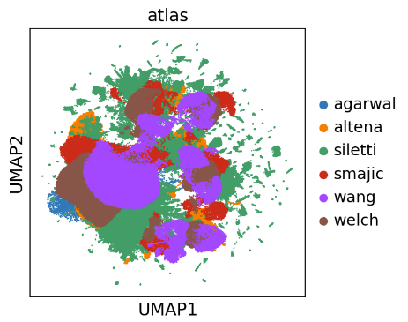
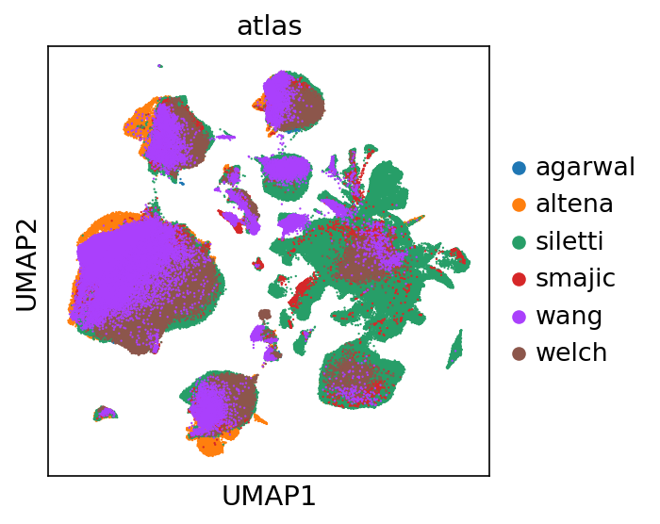
Spoilers

Slide 5

Spoilers
Integration

Slide 6
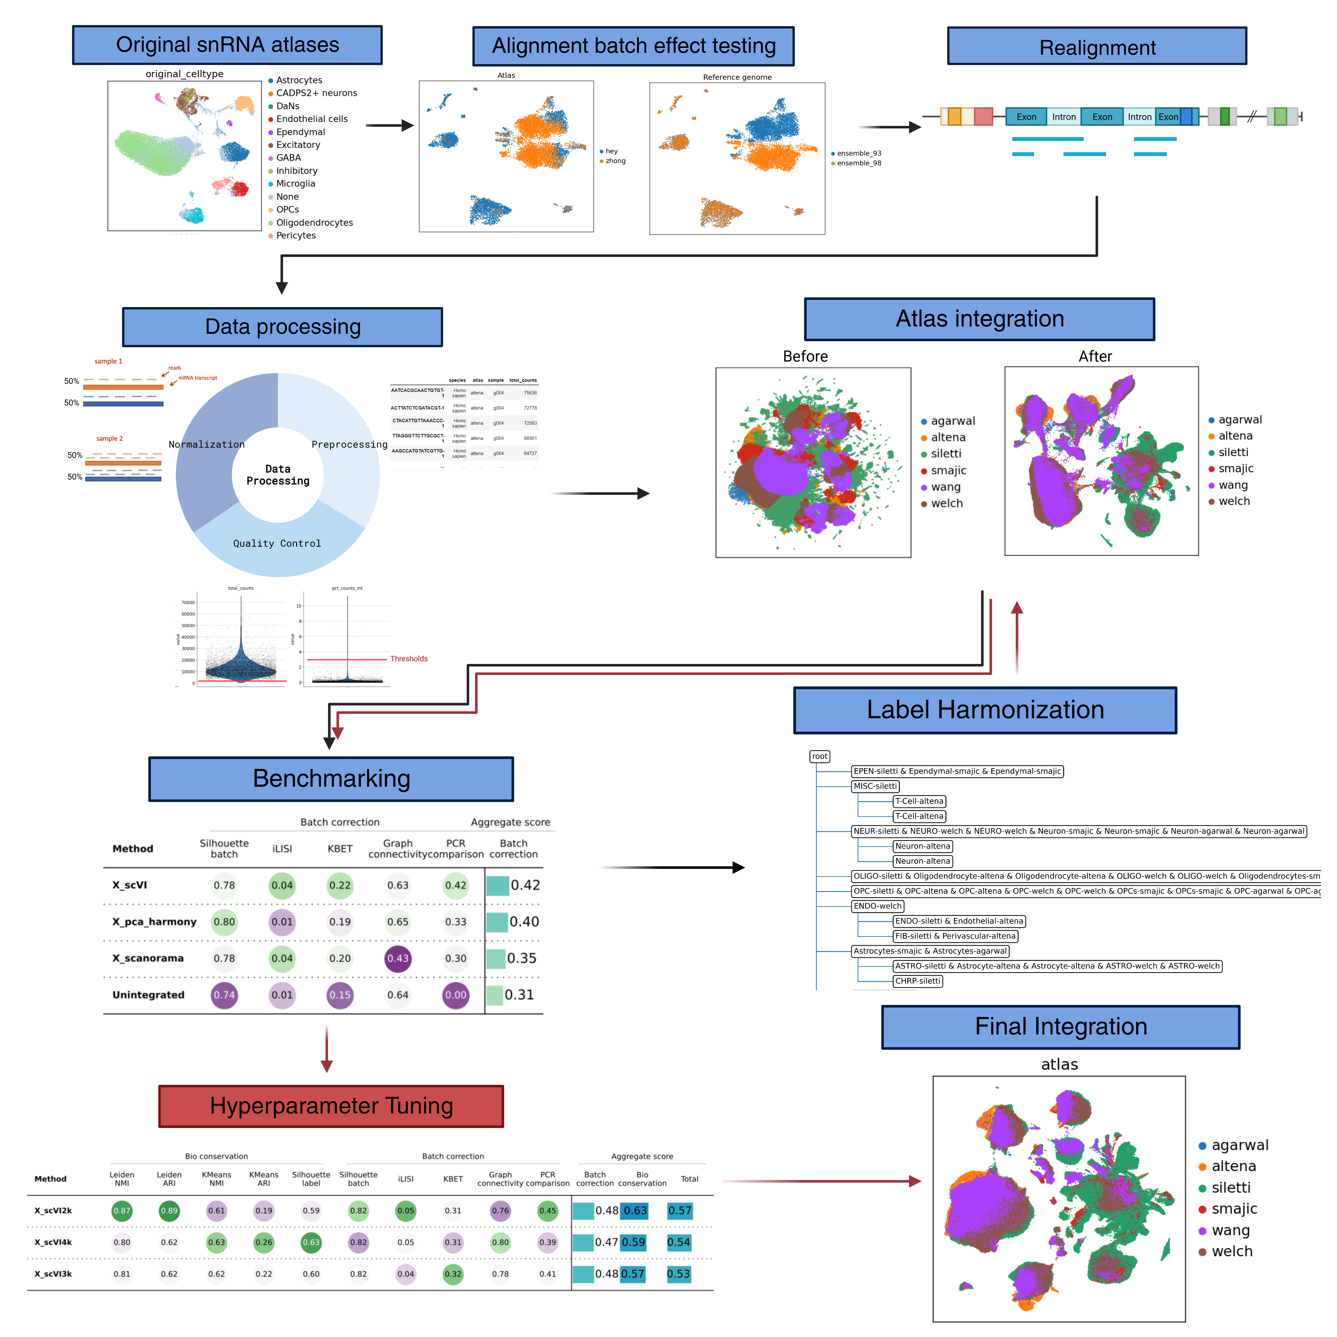
The Pipeline

Slide 7
The Pipeline
1. Tests and Atlas Processing

Slide 8
The Pipeline
1. Tests and Atlas Processing
2. Label Harmonization and Benchmarks

Slide 9
The Pipeline
1. Tests and Atlas Processing
2. Label Harmonization and Benchmarks
3. Final Integration and Analysis

Slide 10
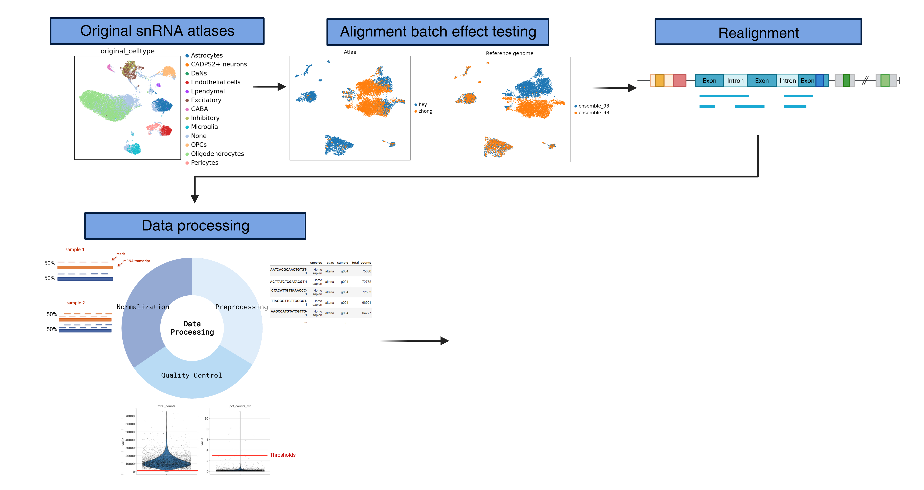
1. Tests and Atlas Processing

Slide 11
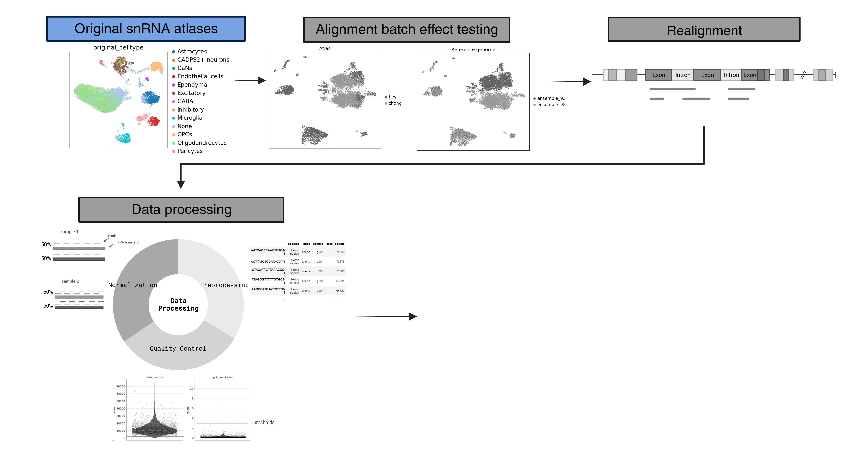
1.1 Original Atlases
snRNA atlas | Cells (unfiltered)
Siletti et. al. (2022) | ~300,000 (midbrain subset)
Smajic et. al. (2021) | ~30,000 (midbrain)
Agarwal et. al. (2021) | ~10,000 (substantia nigra)
Wang et. al. (2022) | ~150,000 (substantia nigra)
Welch et. al. (2019) | ~45,000 (substantia nigra)
van Regteren Altena et. al. | ~90,000 (VTA)
Total | ~625,000 cells

Slide 12
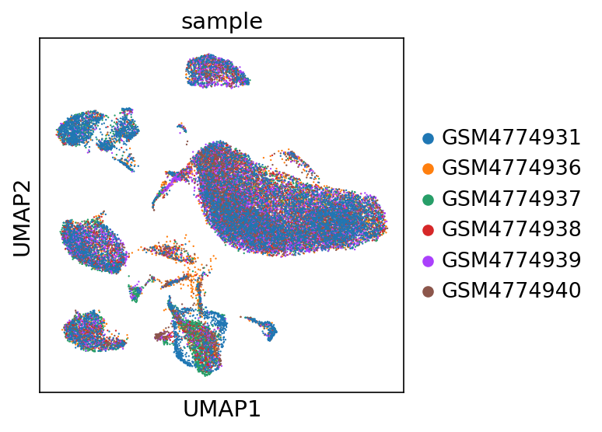
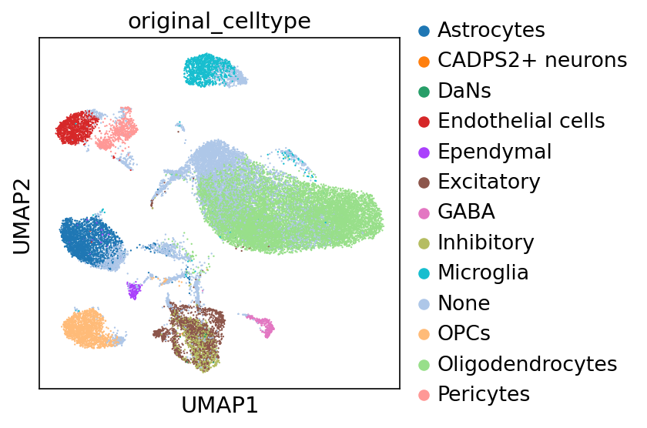
Smajic atlas

Slide 13
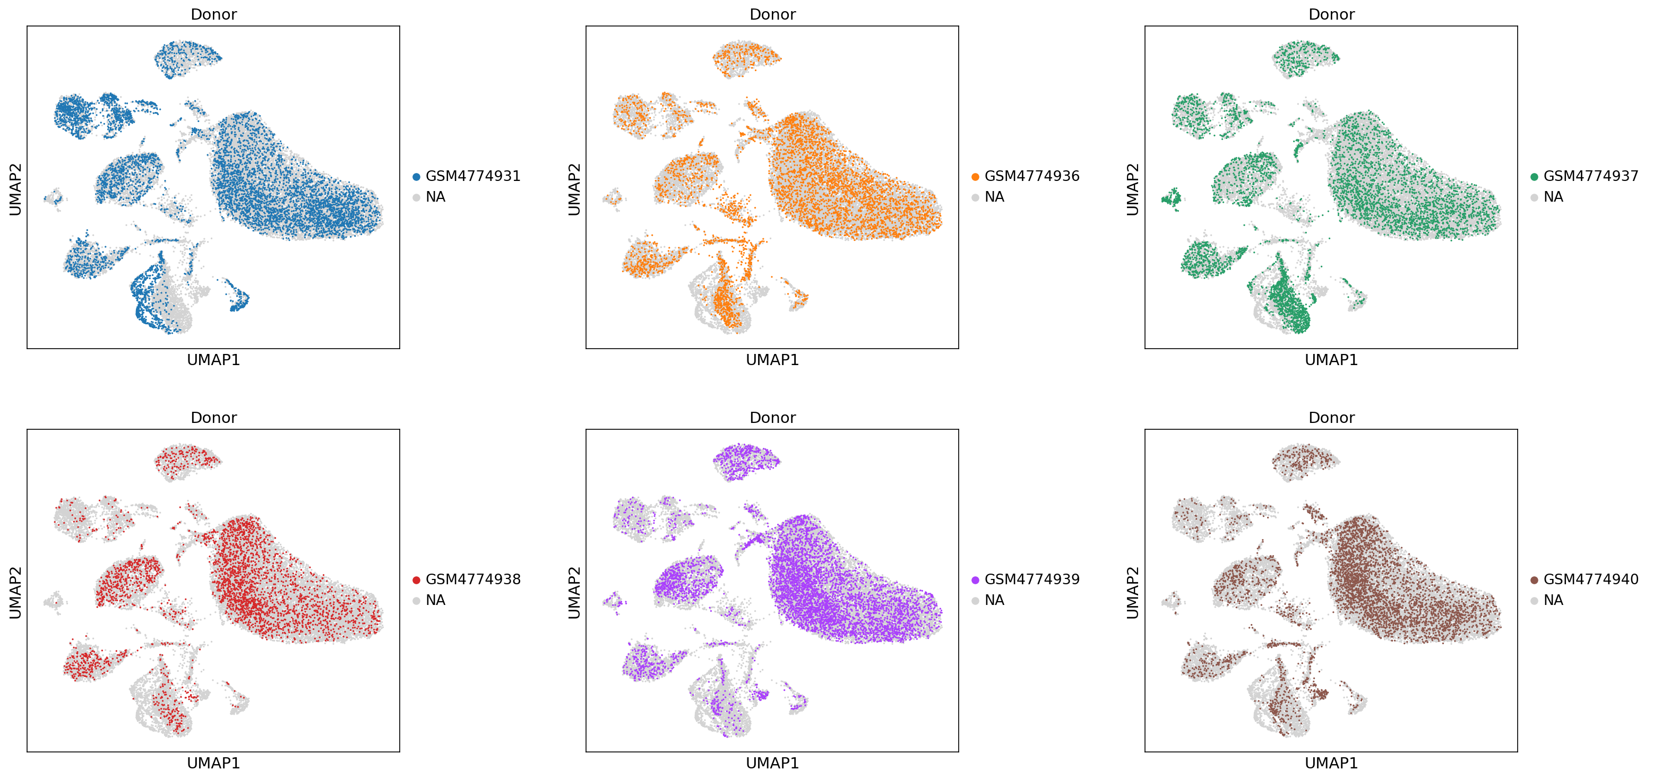
Smajic samples

Slide 14
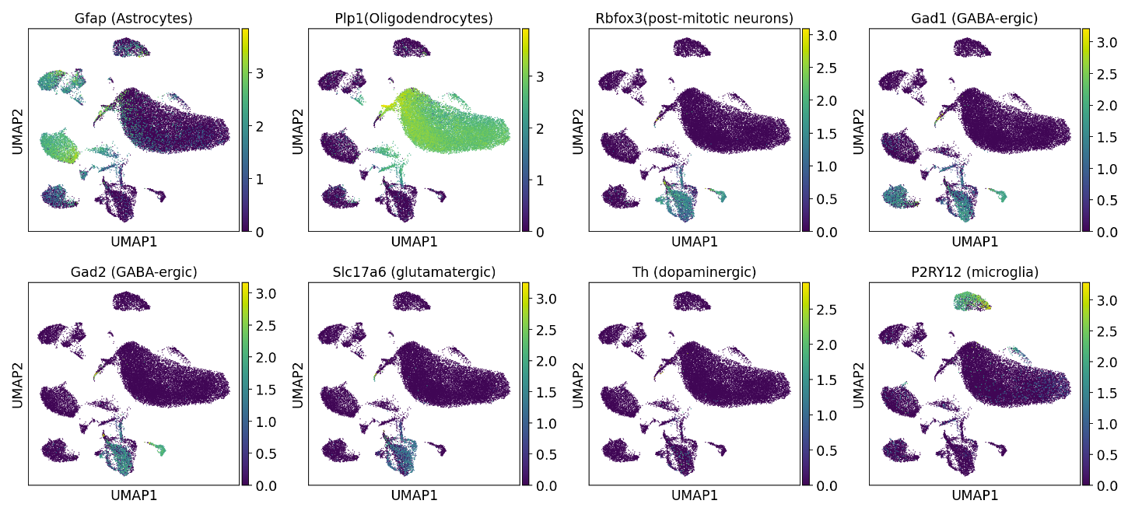
Smajic markers

Slide 15
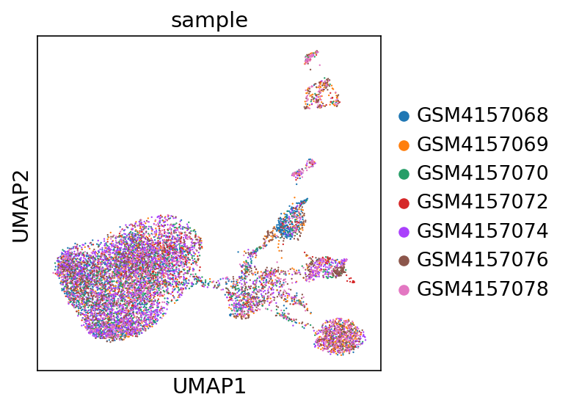
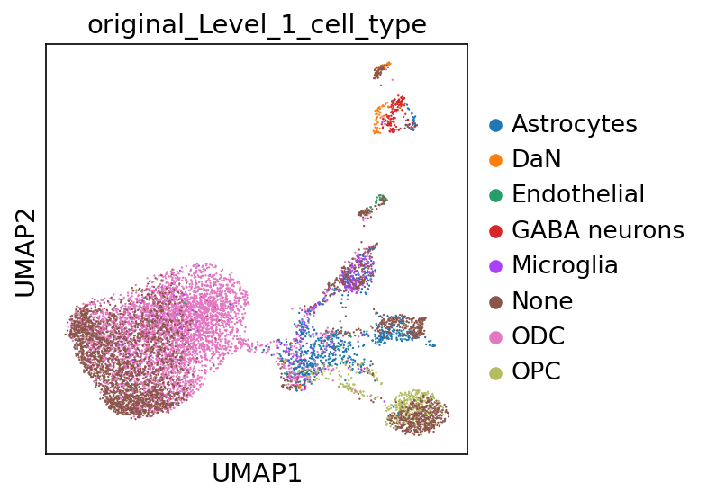
Agarwal atlas

Slide 16
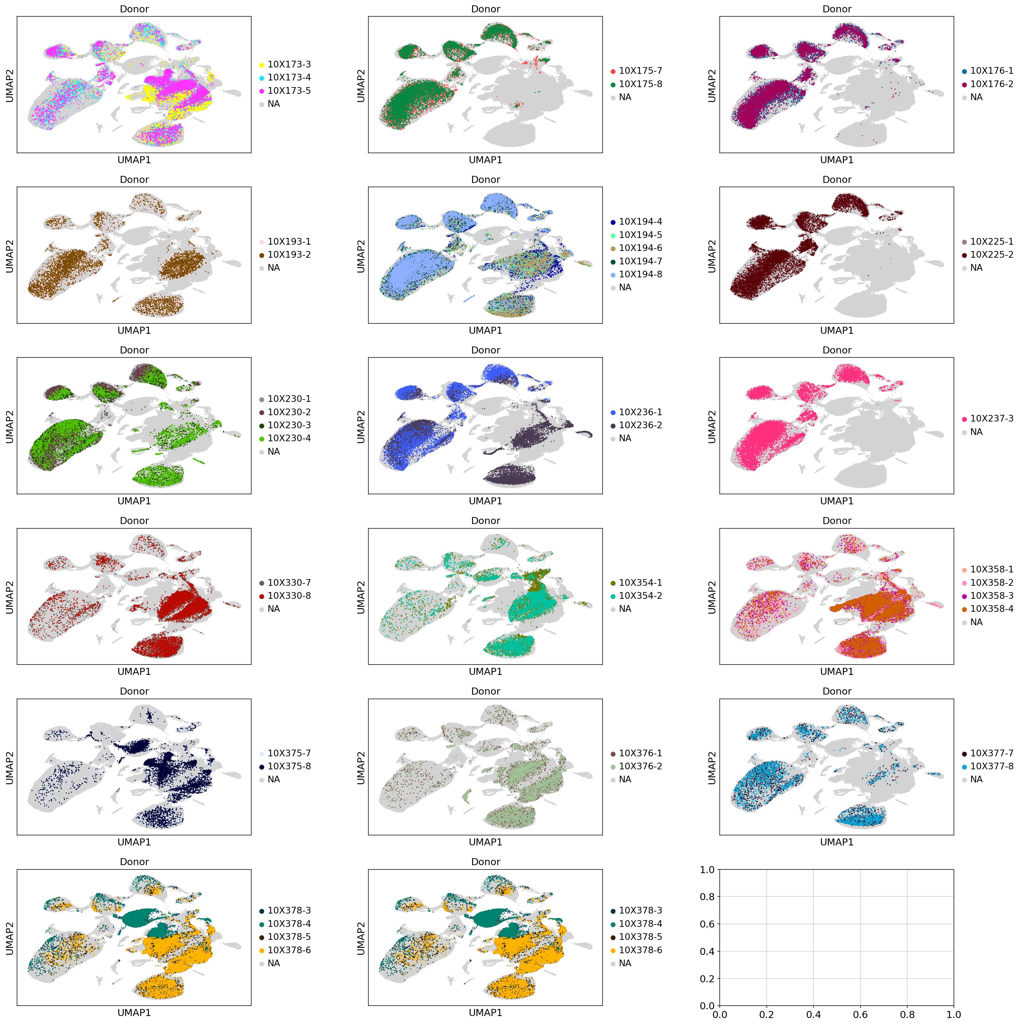
Siletti samples

Slide 17
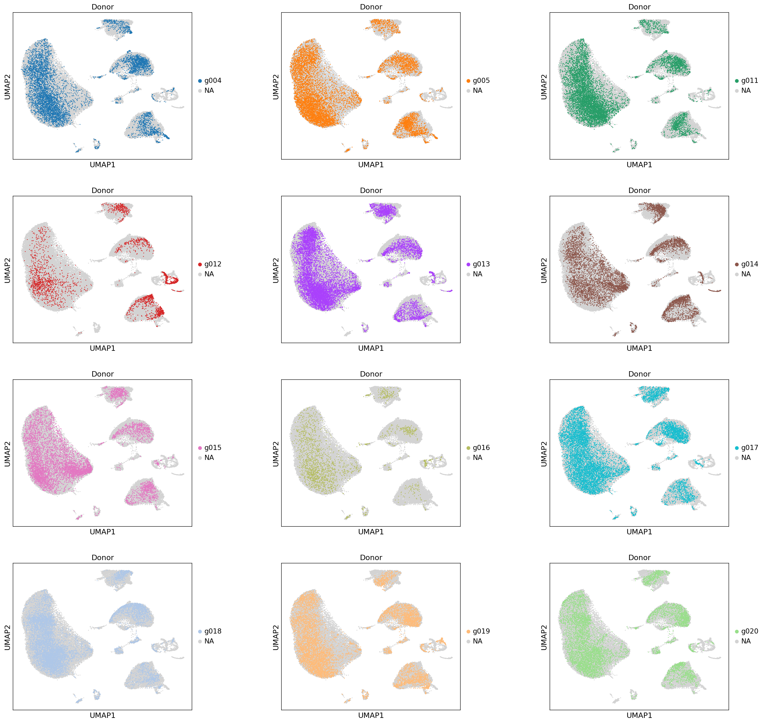
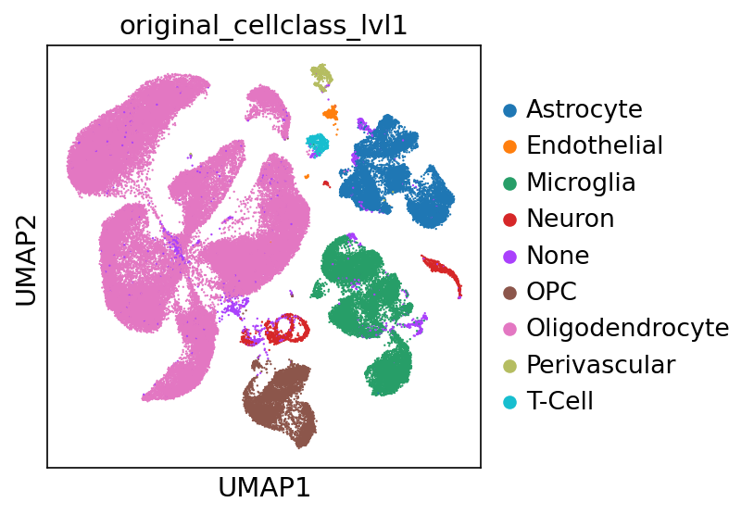
Altena samples

Slide 18
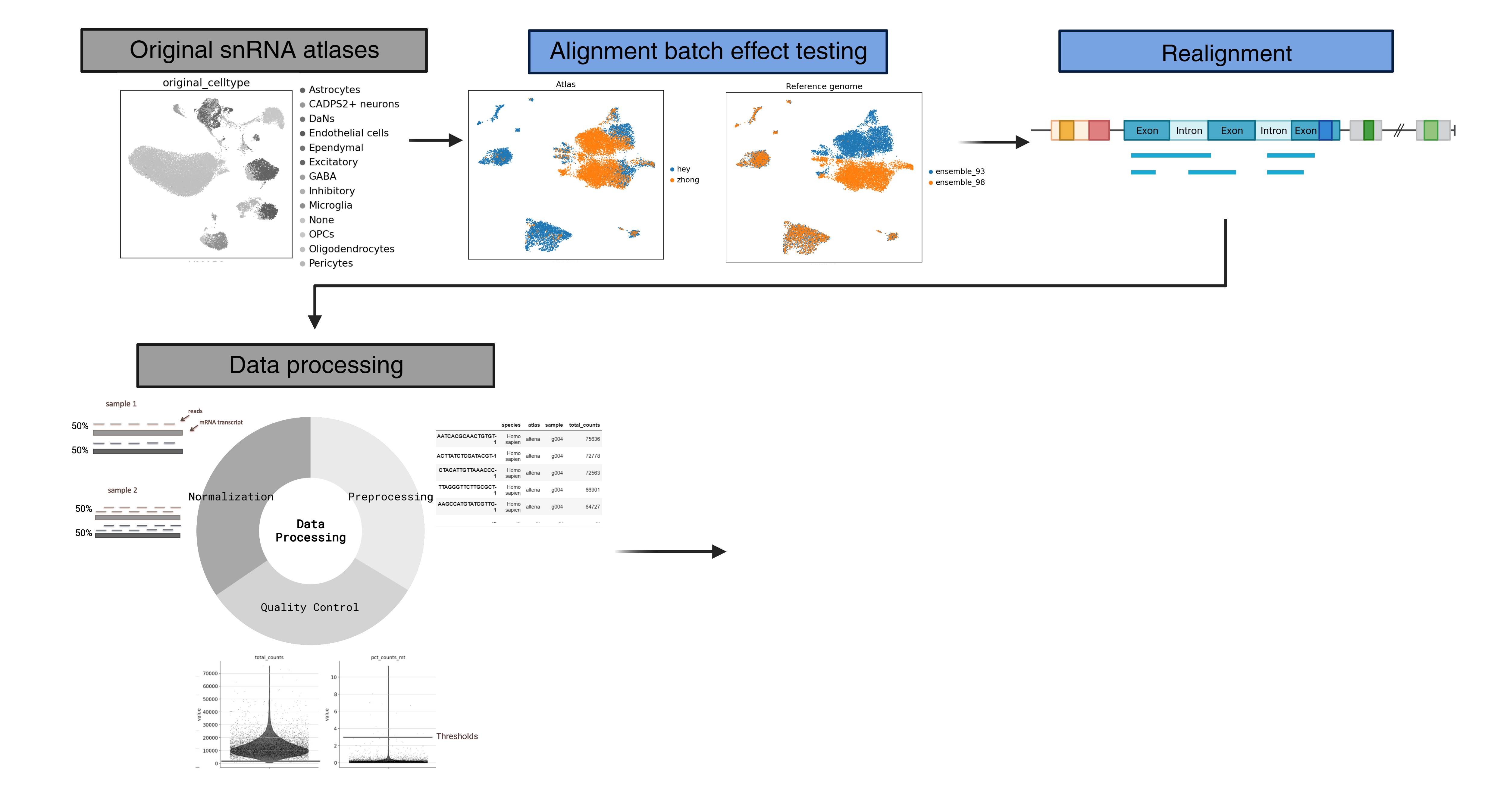
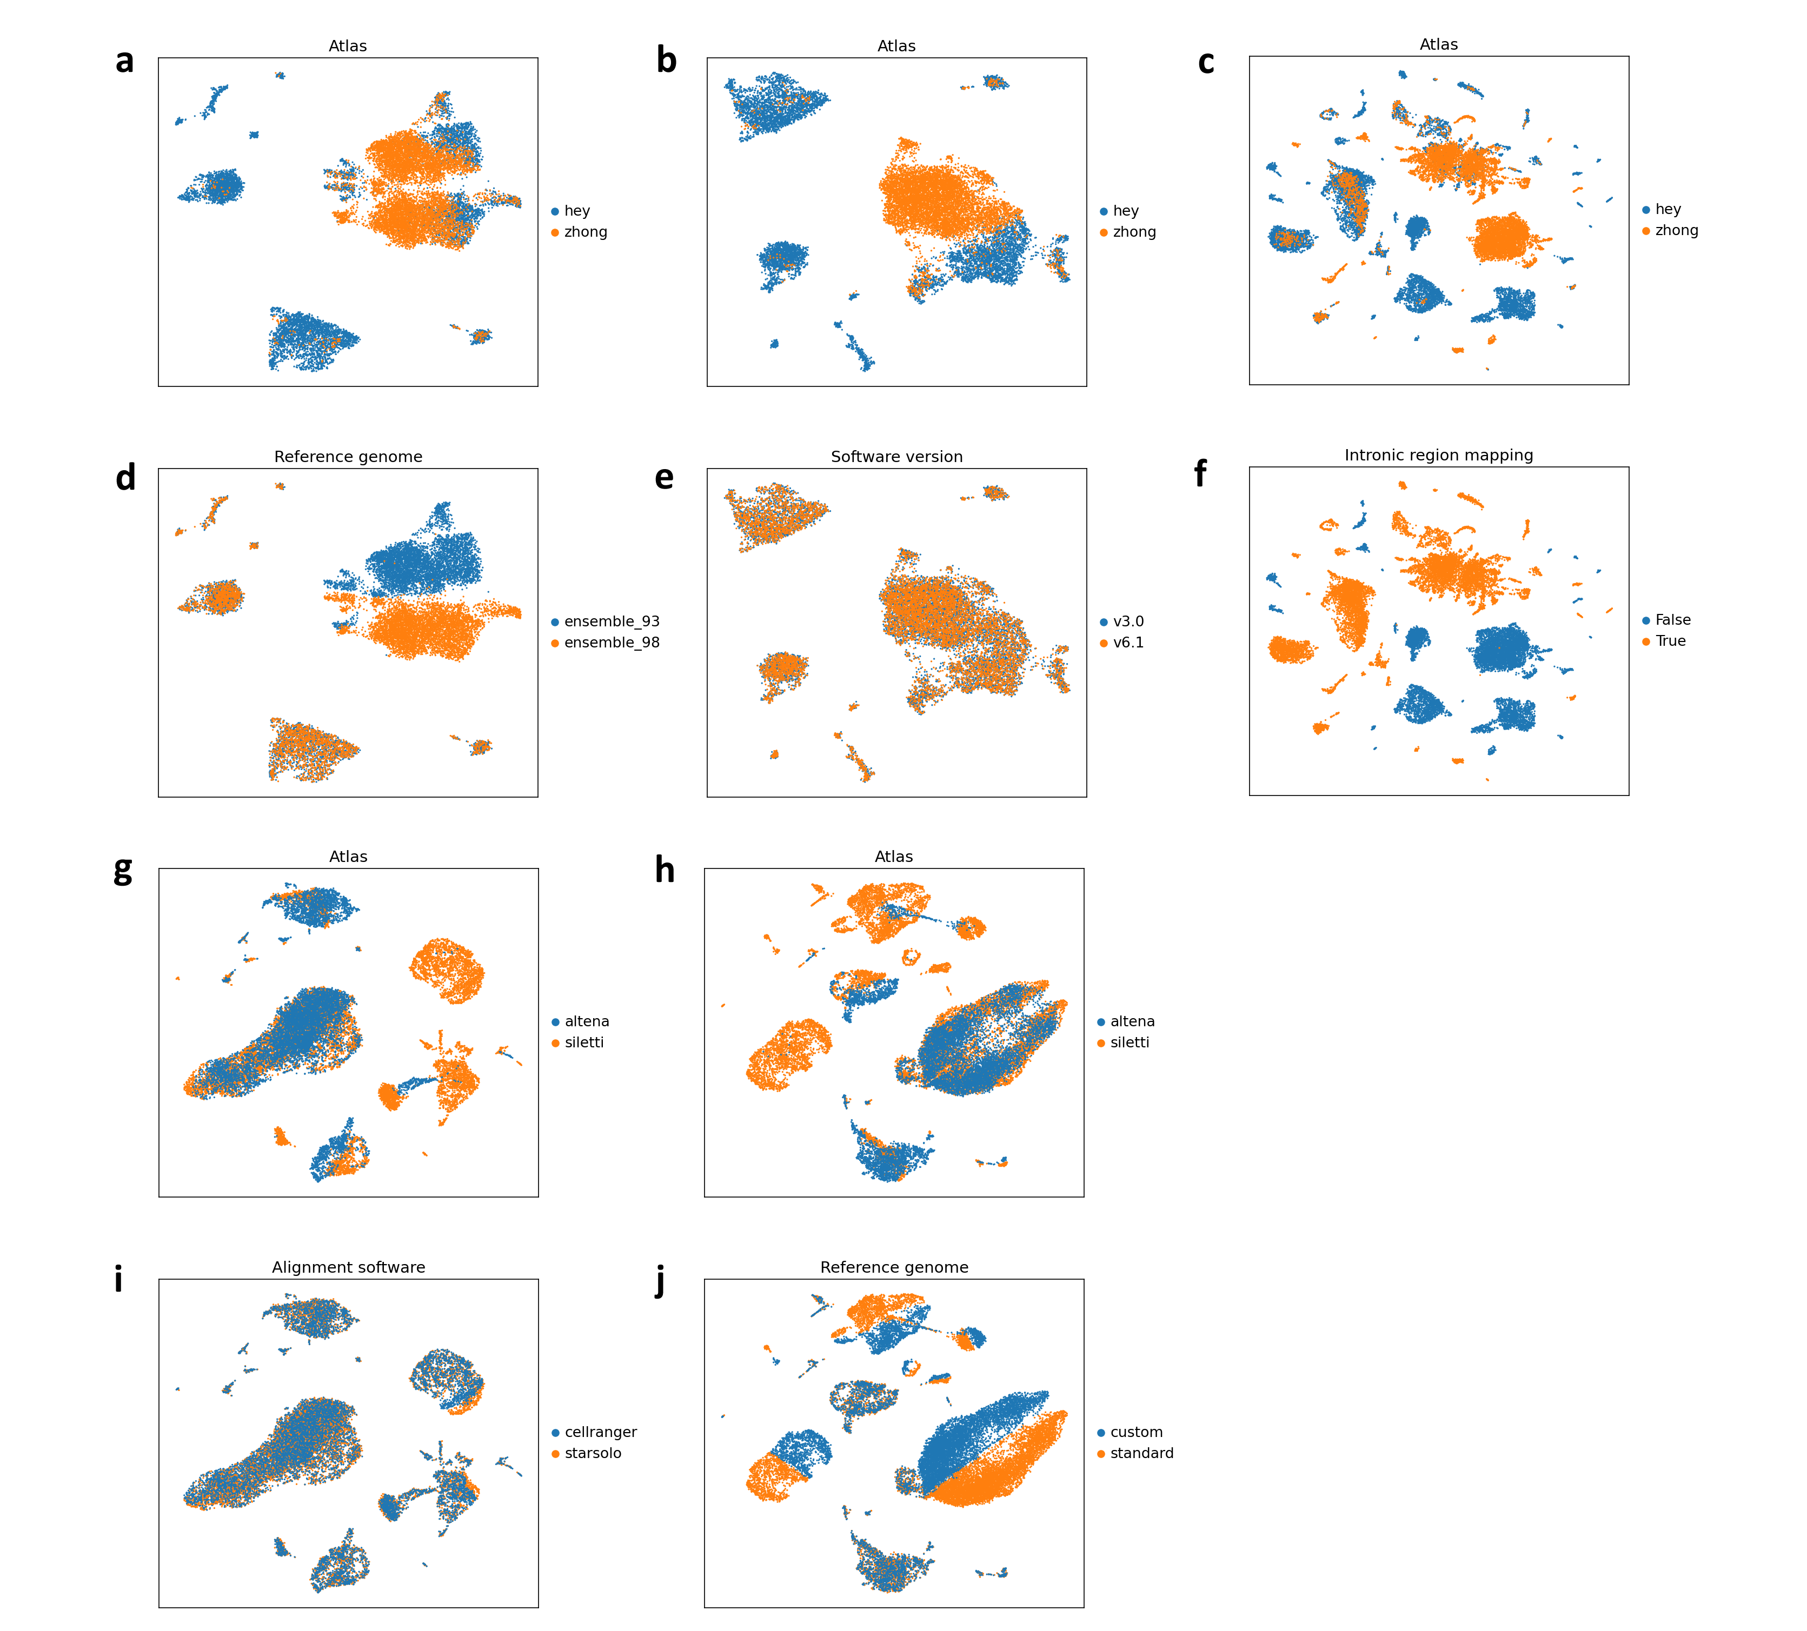
1.2 Tests and Realignment
Problem: Batch effects
Reference genome
Software version (Cell Ranger)
Include intronic mapping

Slide 20
1.2 Tests and Realignment
Problem: Batch effects
Software
Reference genome

Slide 21
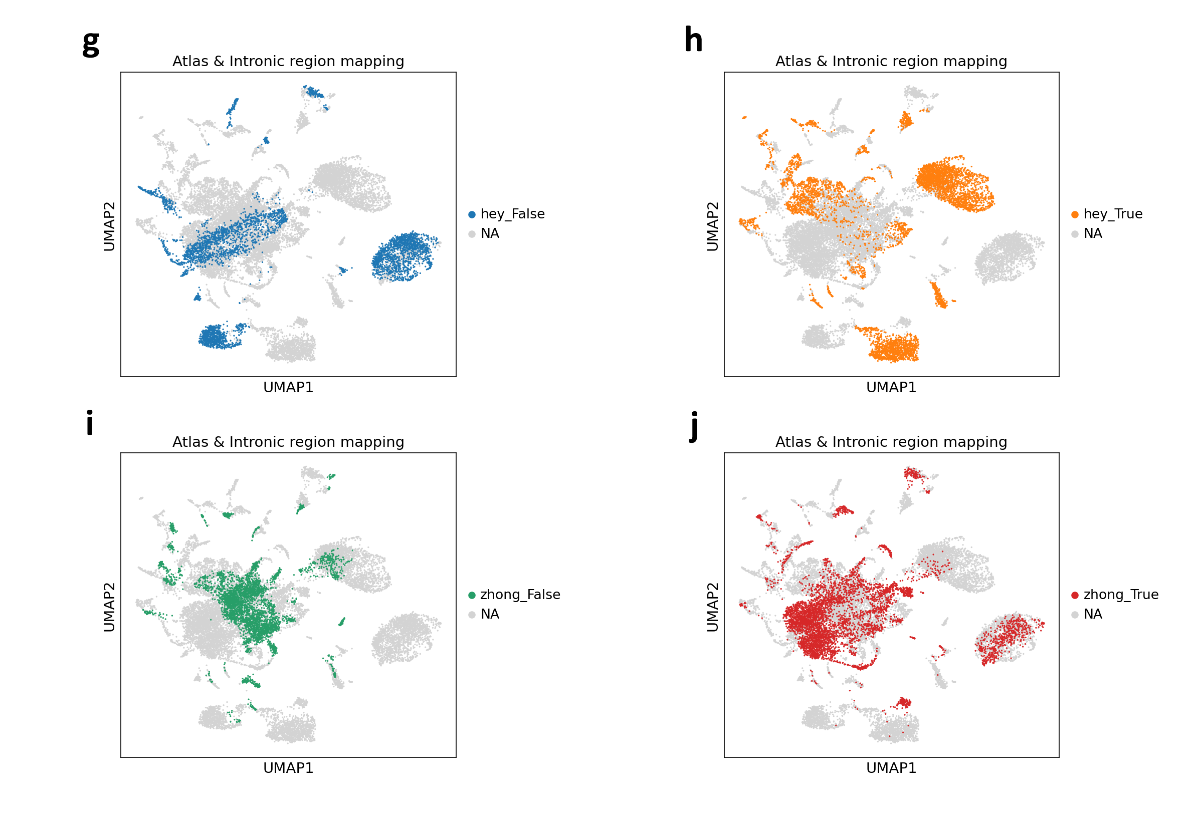
More tests: intronic mapping regress and highly-variable genes

Slide 22
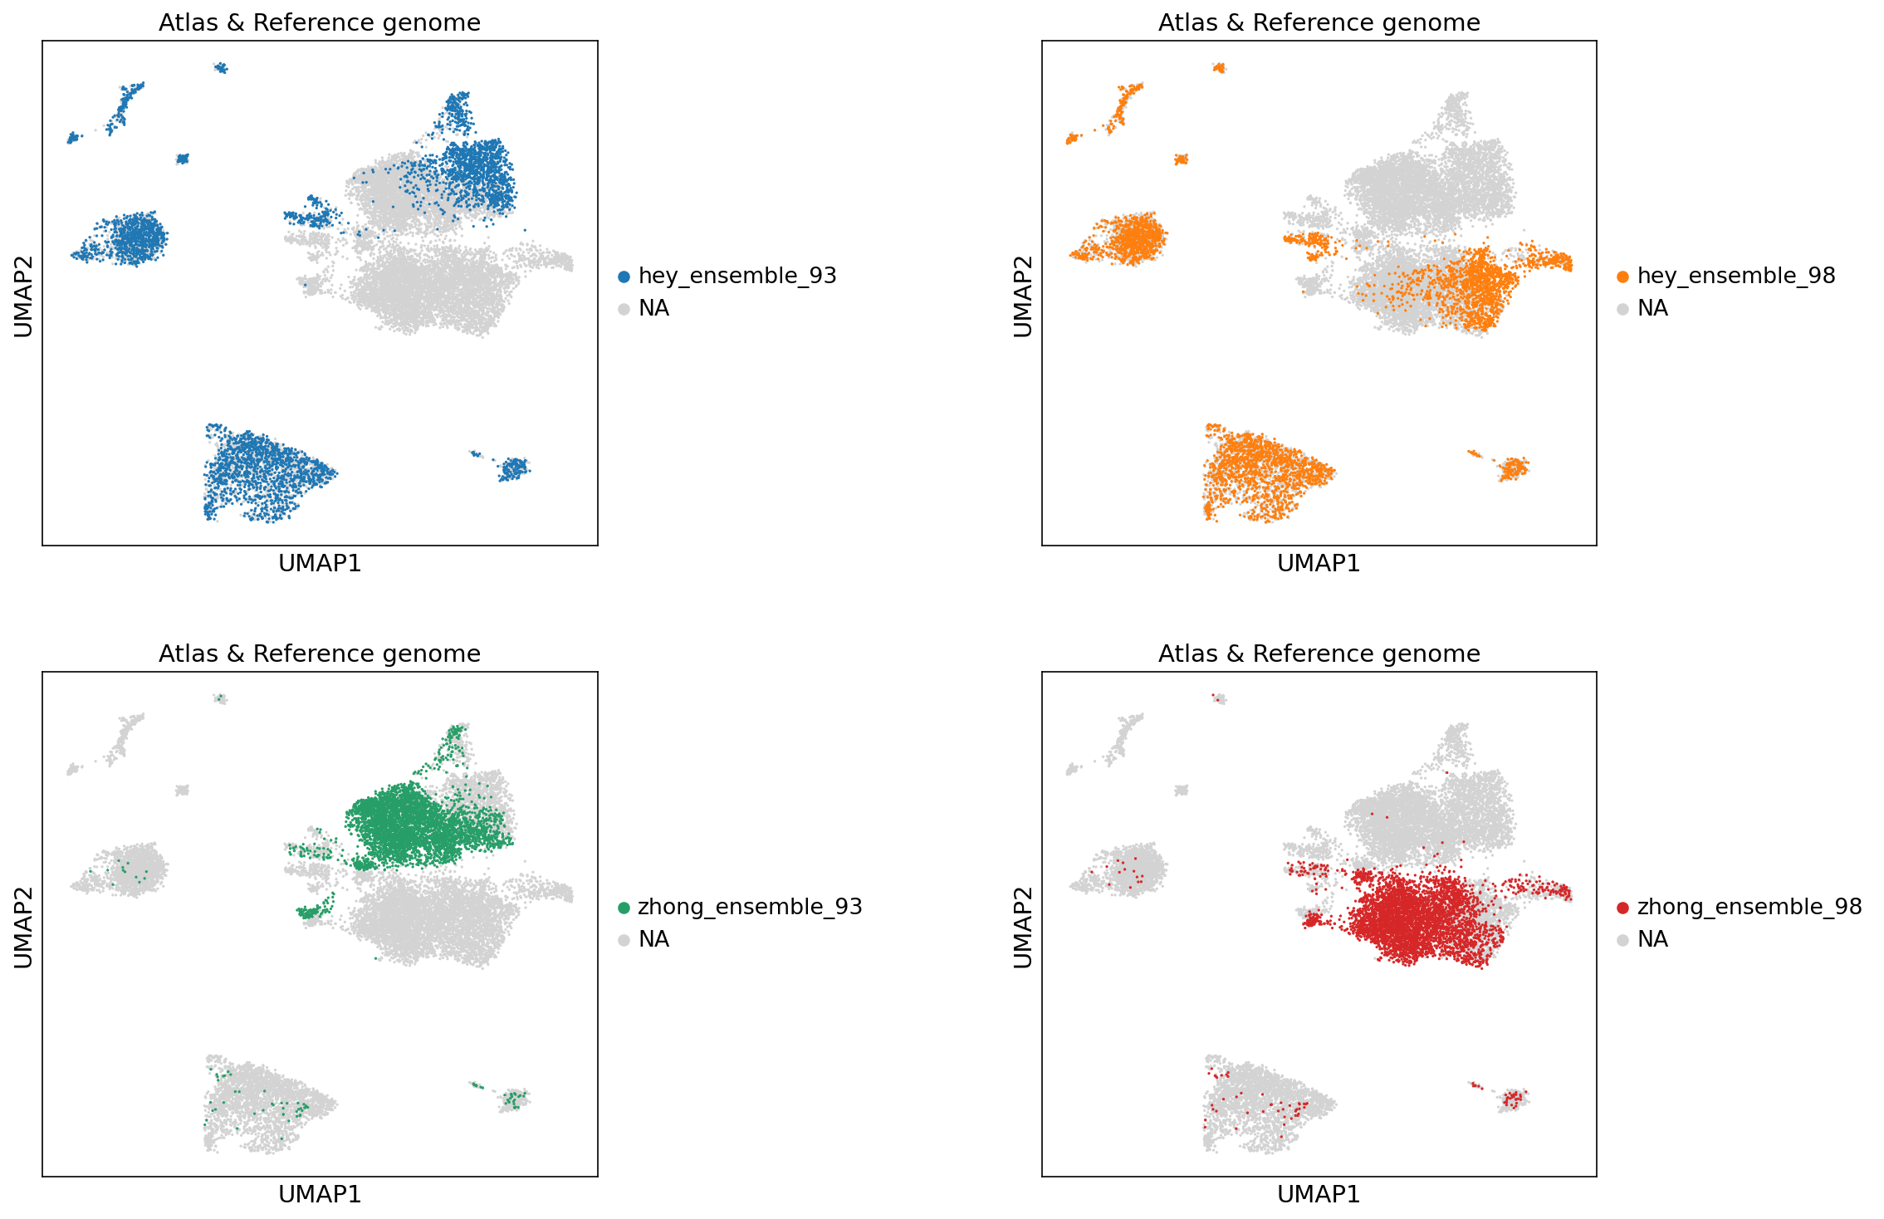
More tests: reference genome mouse

Slide 23
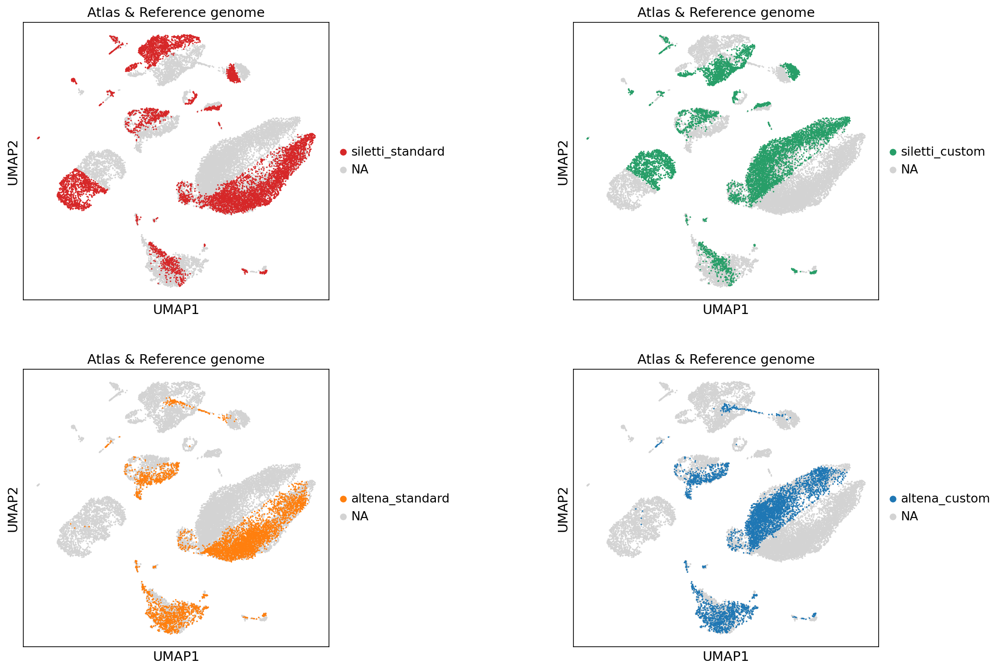
More tests: reference genome (human)

Slide 24
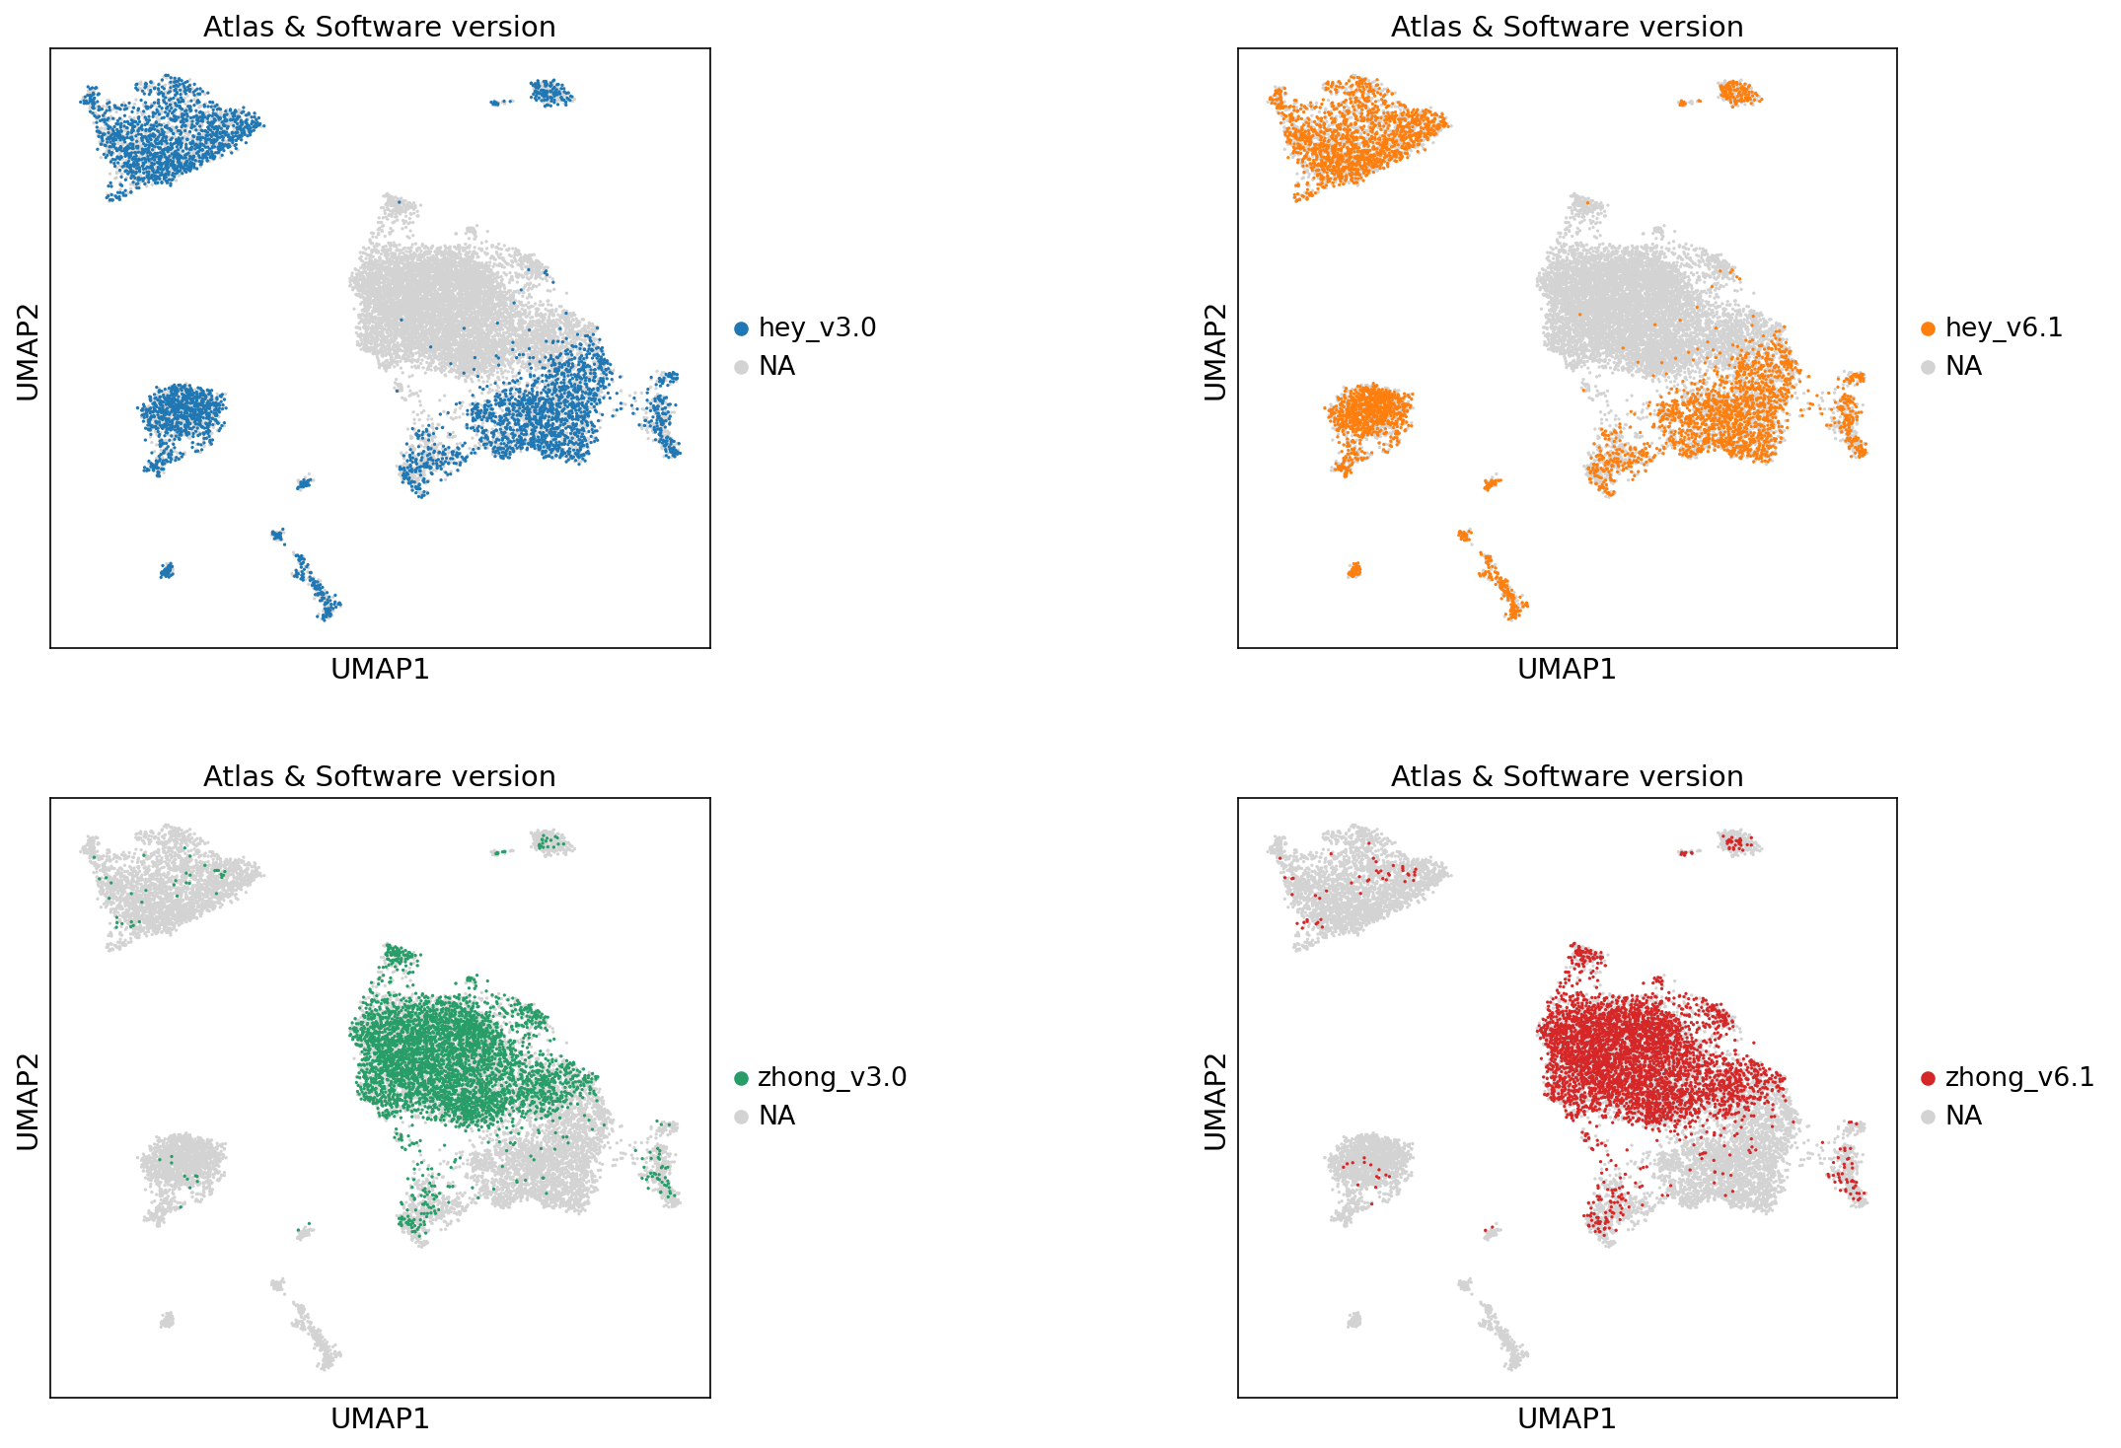
More tests: software version

Slide 25
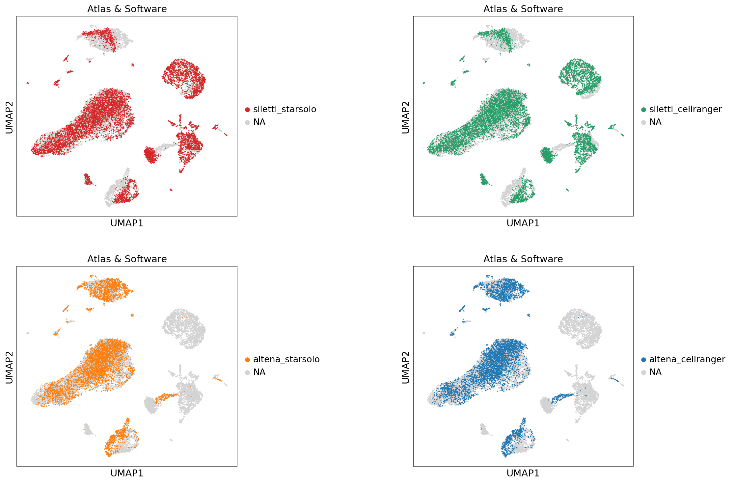
More tests: software (human)

Slide 26
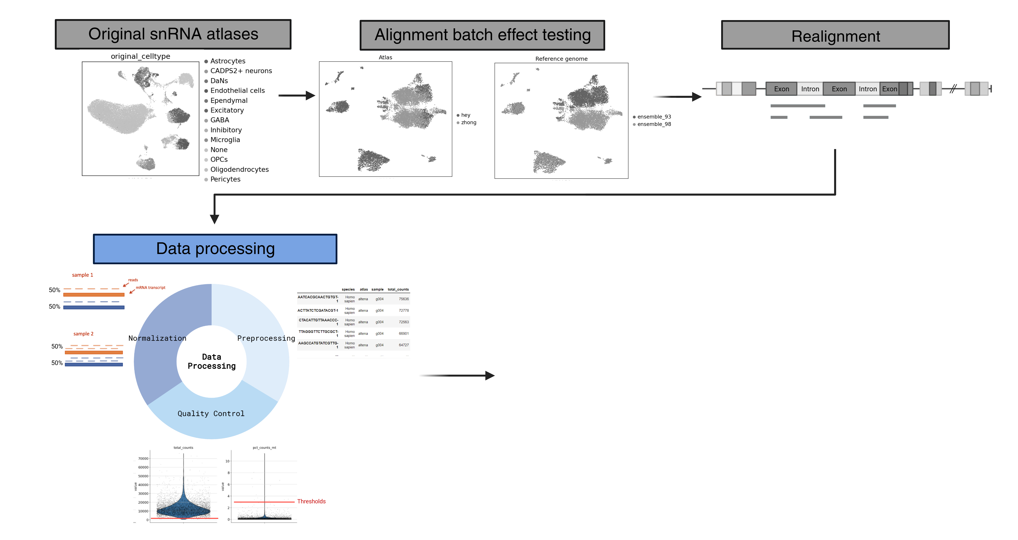
1.3 Data processing

Slide 27
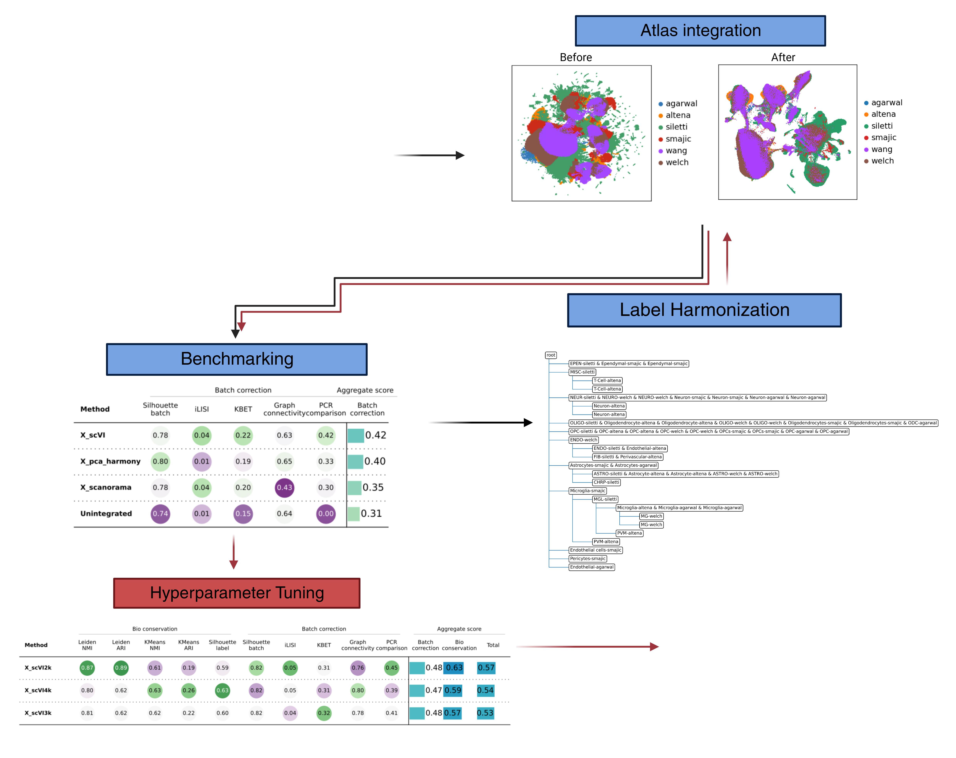
2. Label Harmonization and Benchmarks

Slide 28
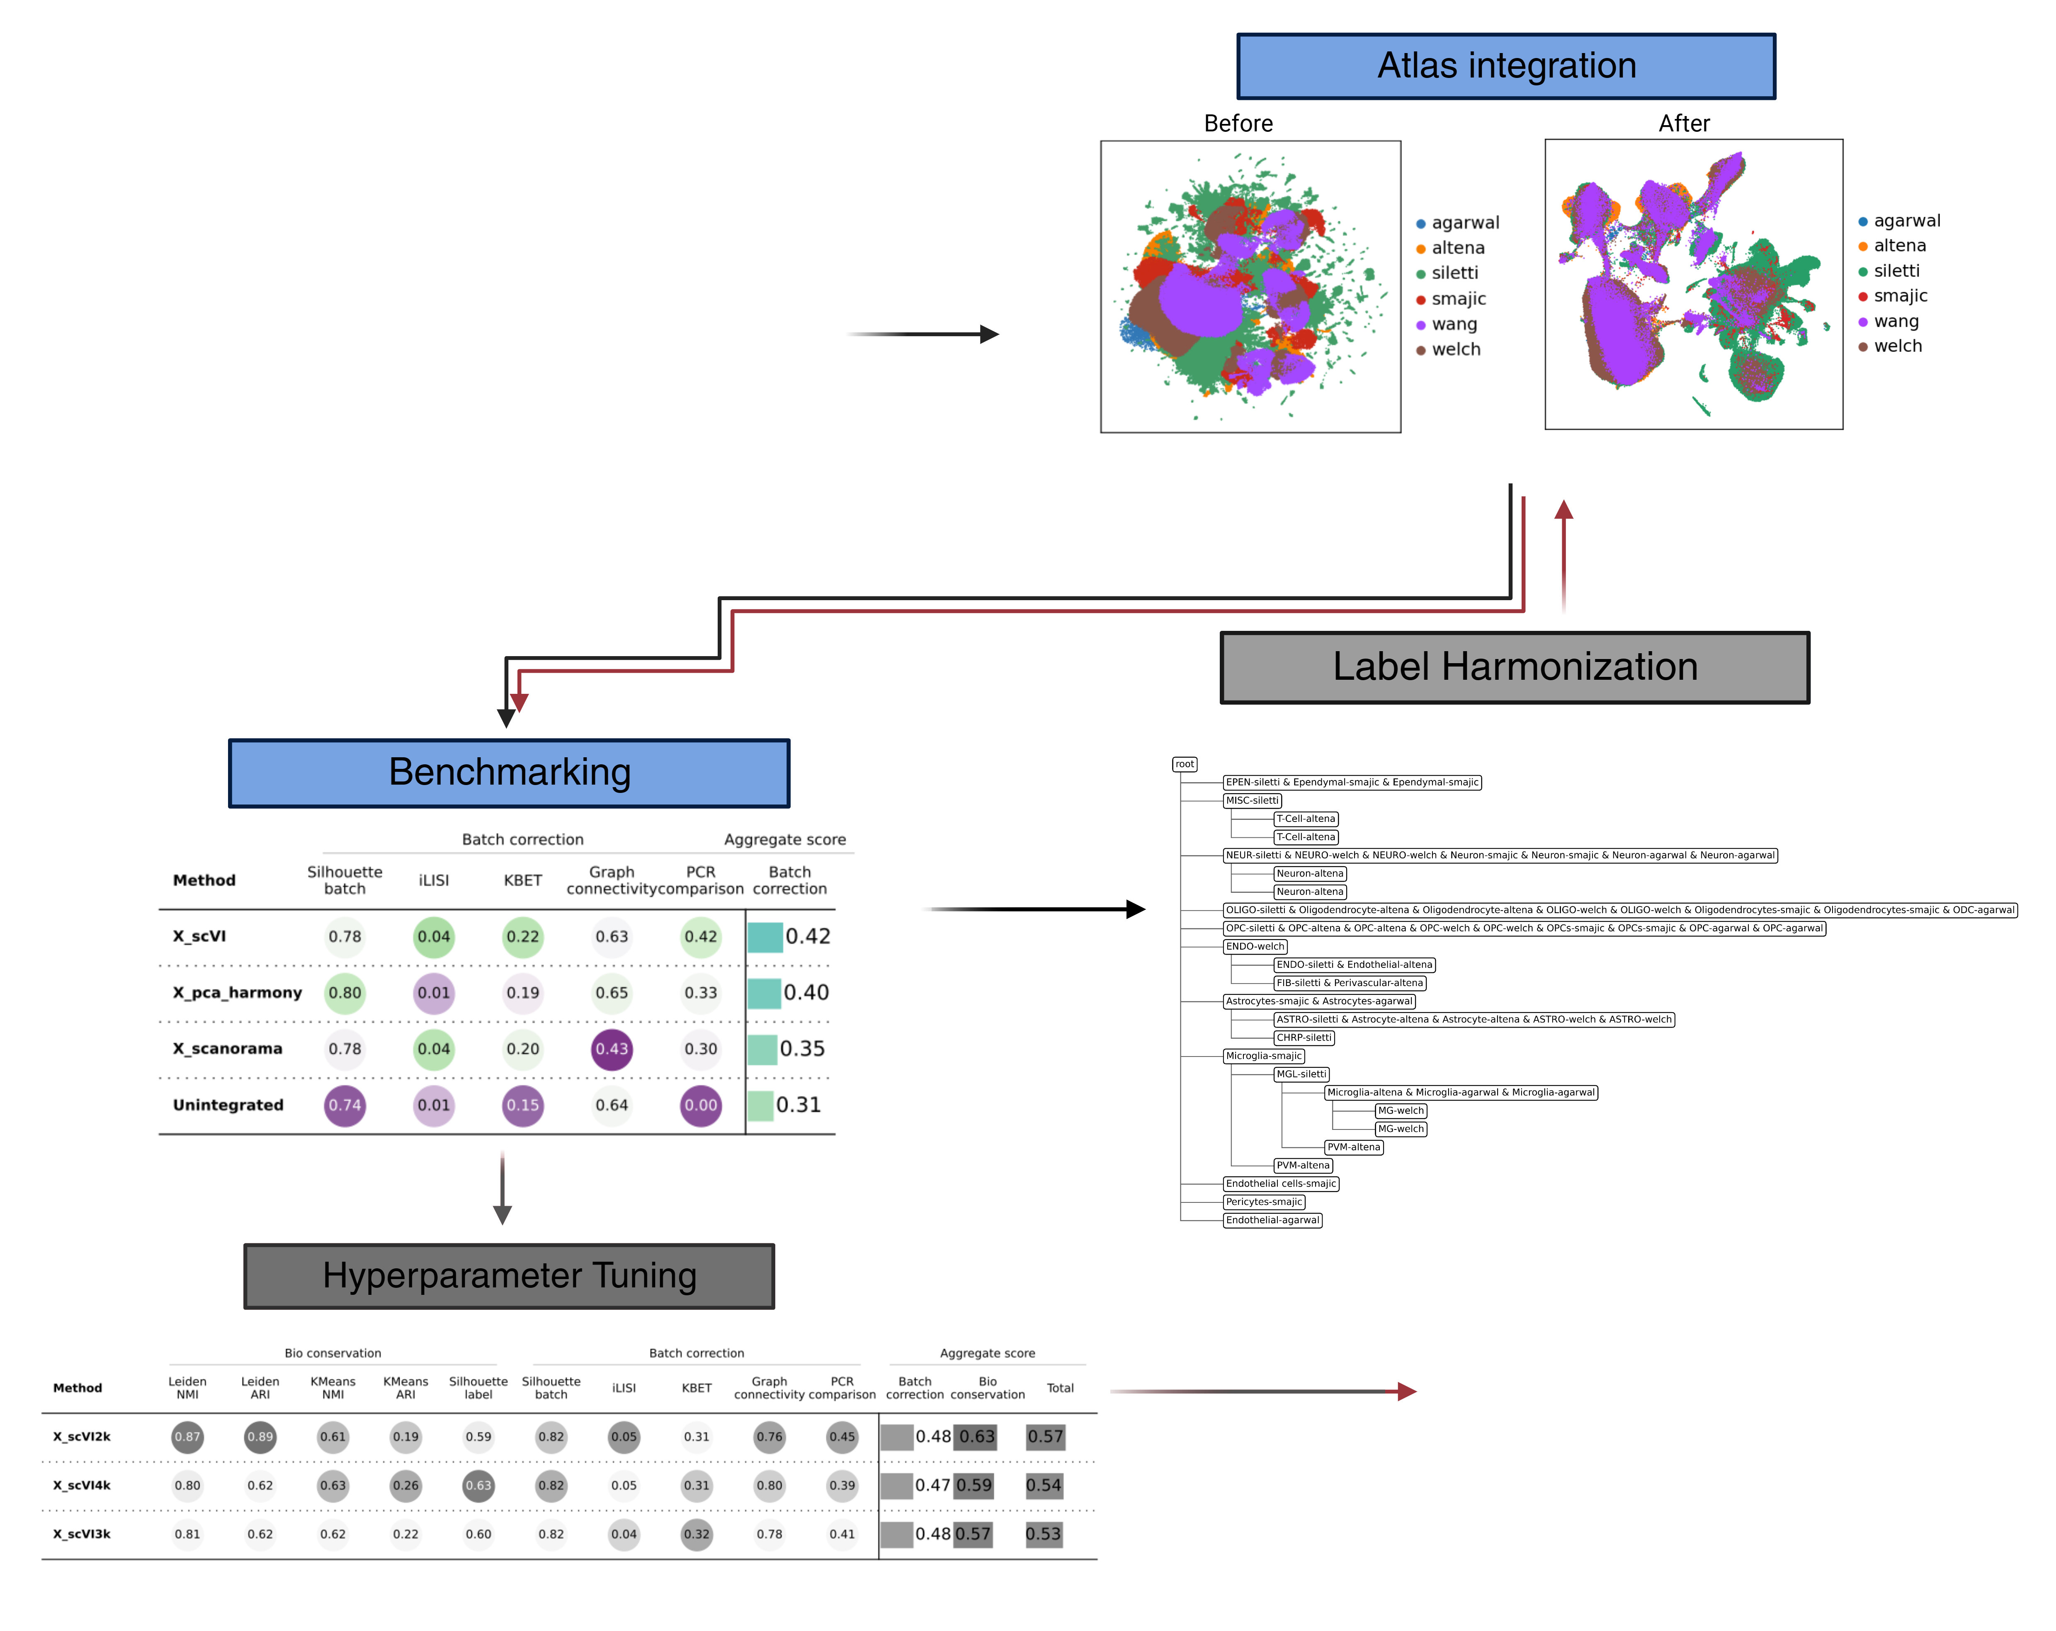
2.1 Integration evaluation (with Scib)
Problem: Which integration method to use?

Slide 29
2.1 Integration evaluation (with Scib)
Problem: Which integration method to use?

Slide 30
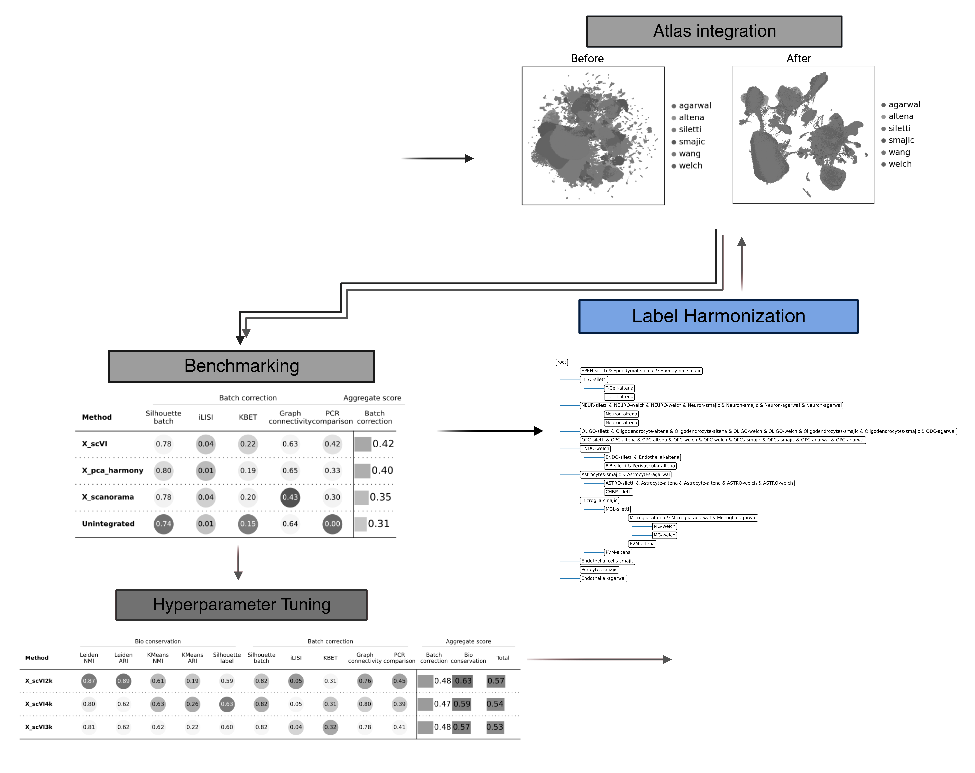
2.2 Label Harmonization (with scHPL)
Problem: Unique labels, specific resolution levels and no annotation

Slide 31
2.2 Label Harmonization (with scHPL)
Problem: Unique labels, specific resolution levels and no annotation

Slide 32
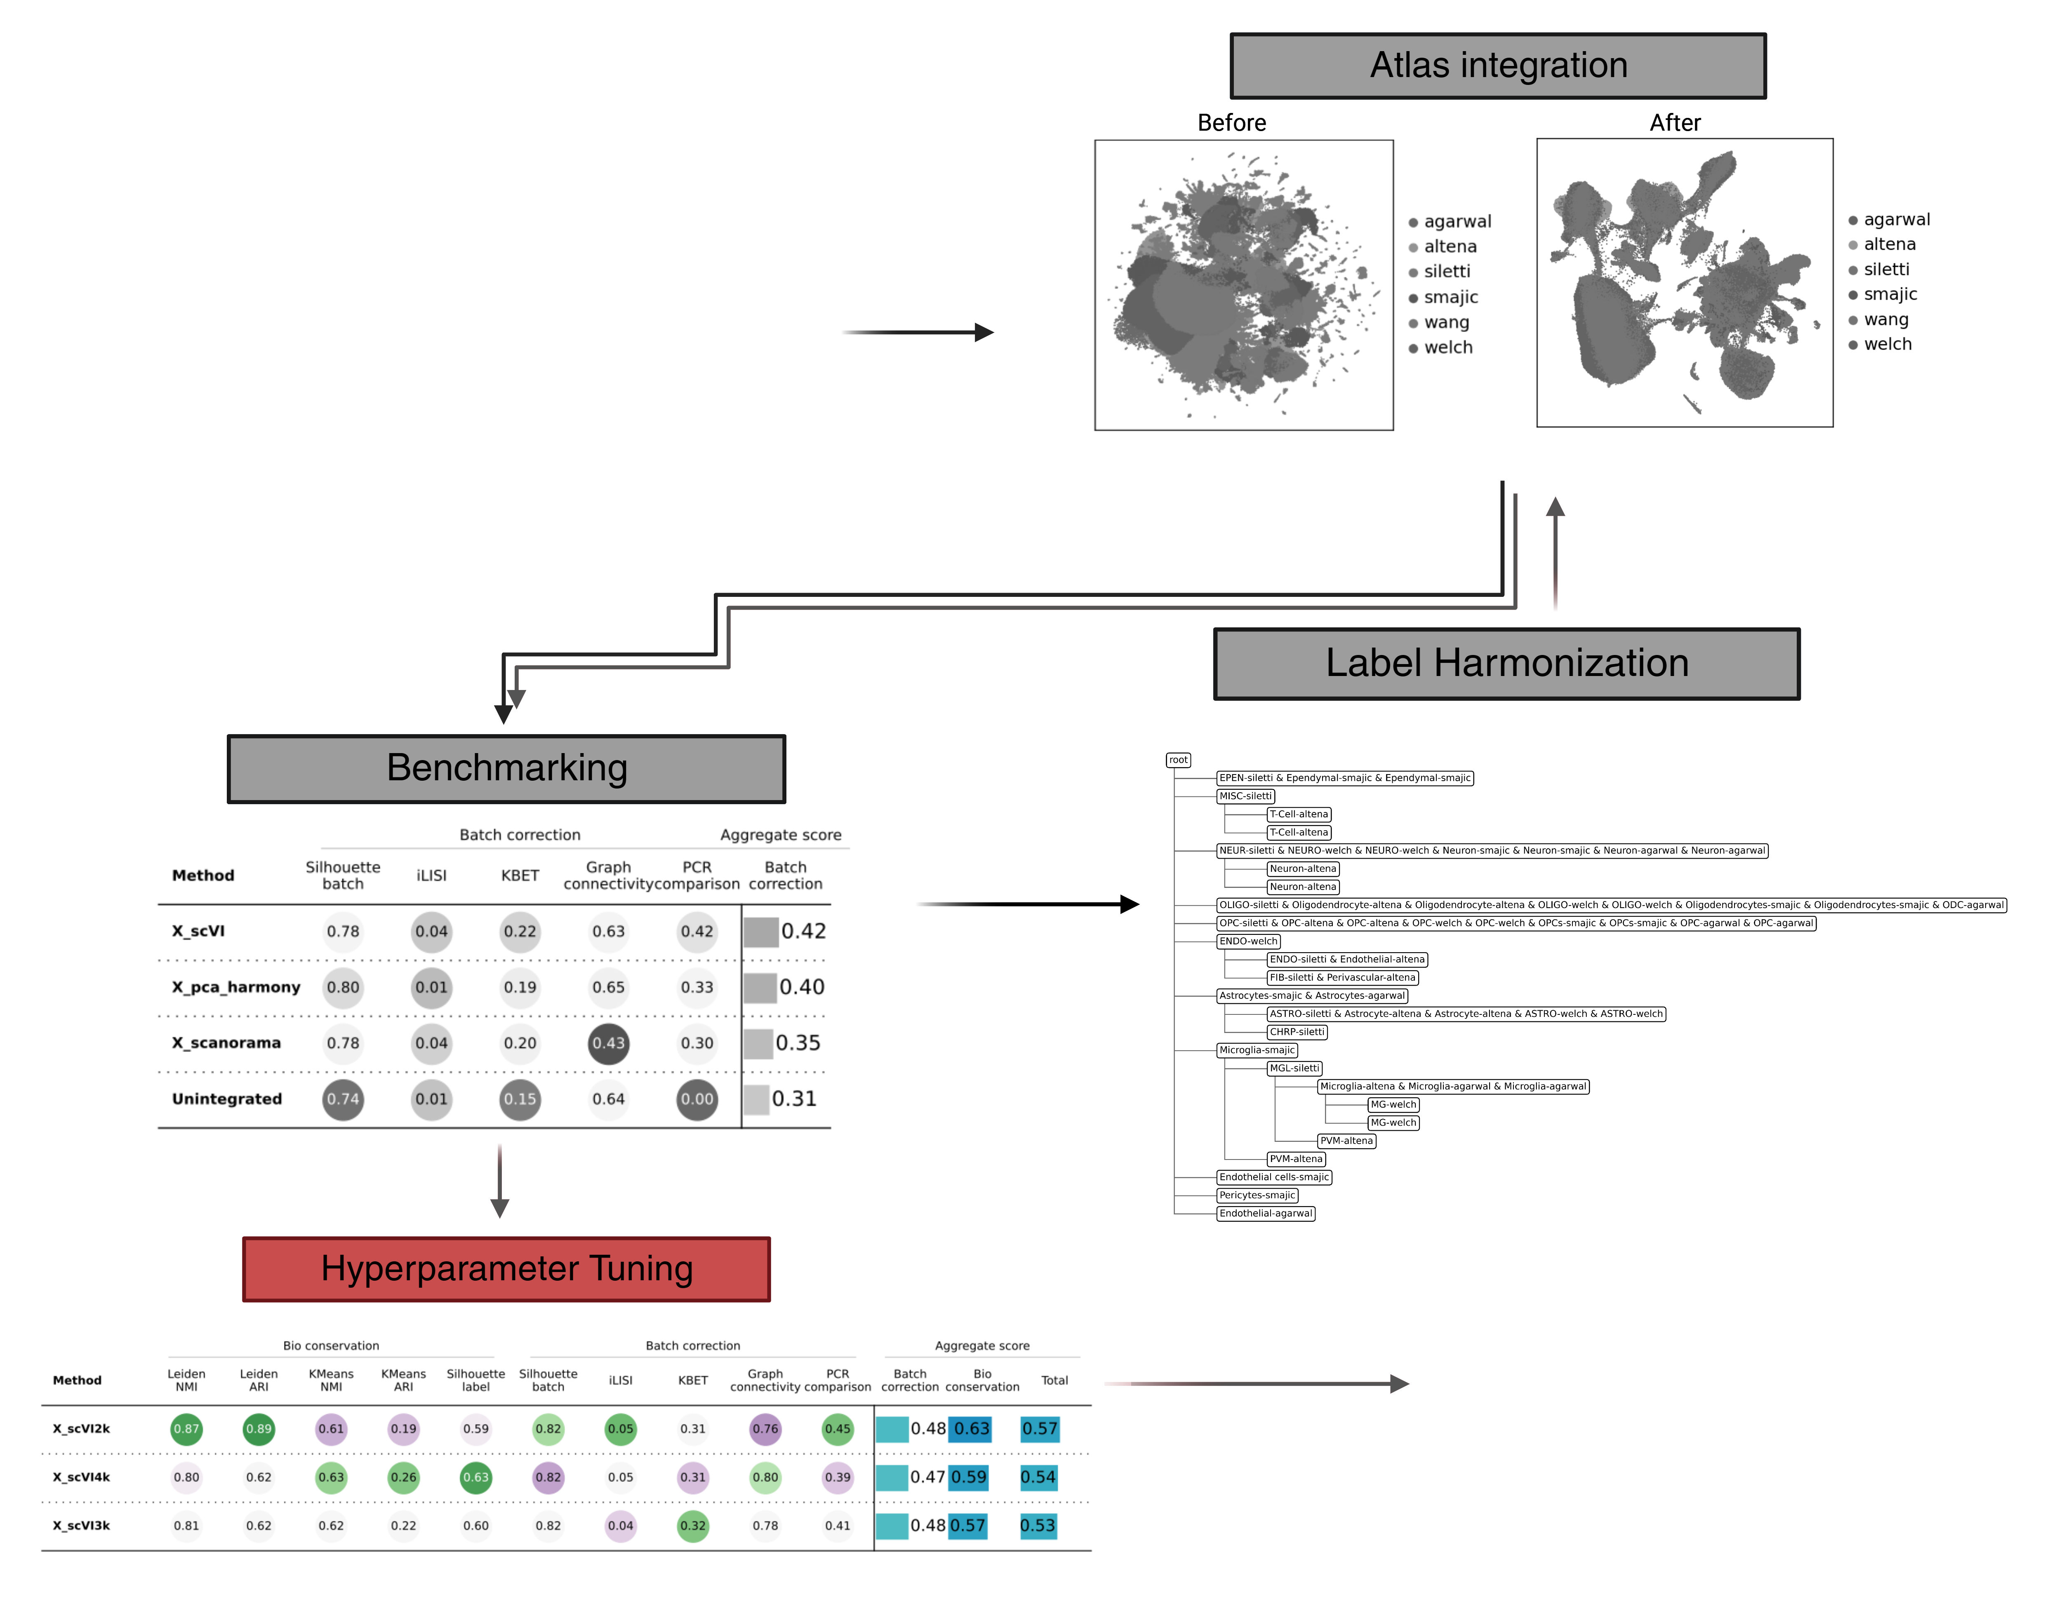
2.3 Hyperparameter Tuning
Hyperparameters of scVI
# High-Variance Genes (2k, 3k, 4k)
# Latent Features (10, 50, 90)
# Hidden Layer (1, 3, 5)
# Hidden Nodes (64, 128, 256)
!Evaluated independently and include bio-conservation metrics

Slide 33
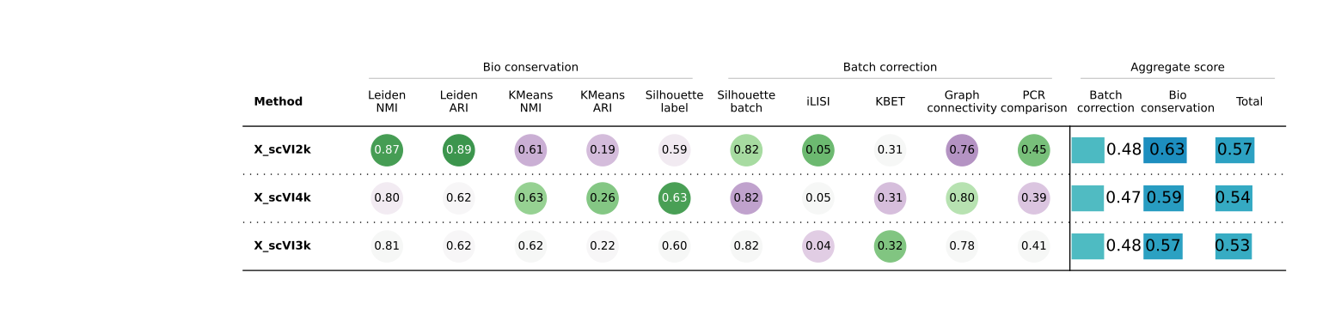
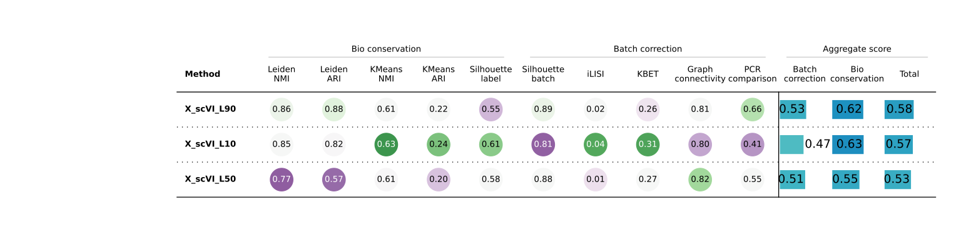
# High-Variance Genes and Latent Features

Slide 34
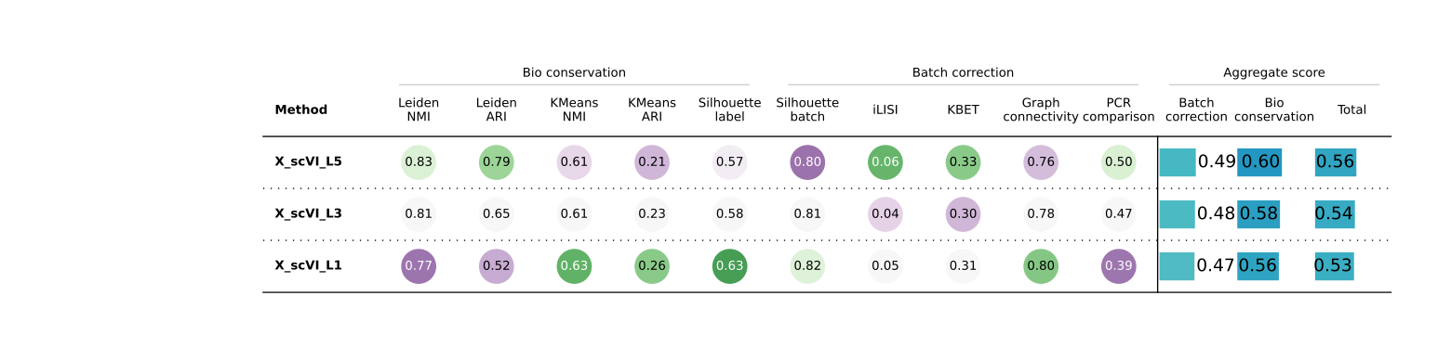
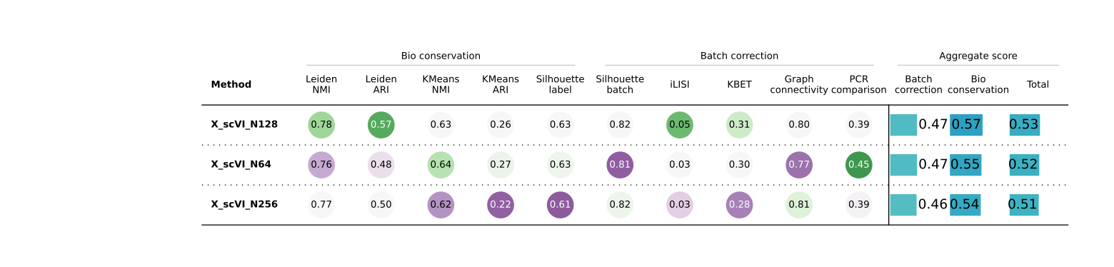
# Hidden Layer and Nodes

Slide 35
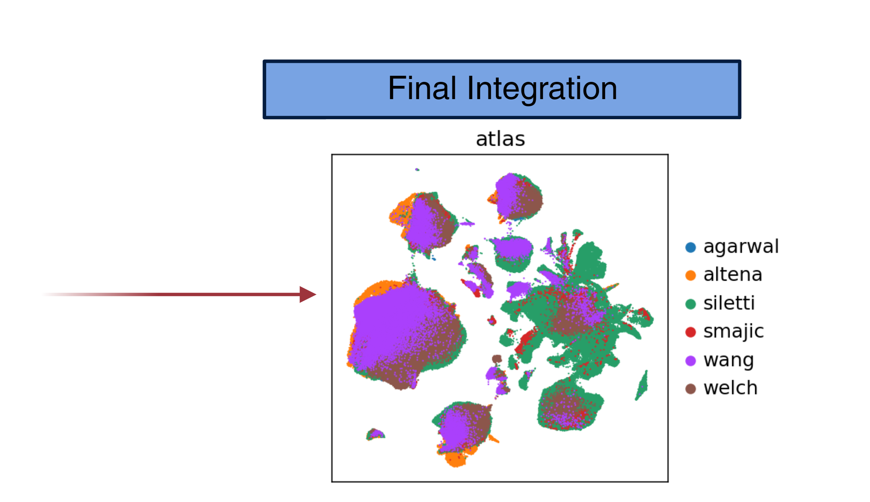
3. Final Integration and Analysis

Slide 36
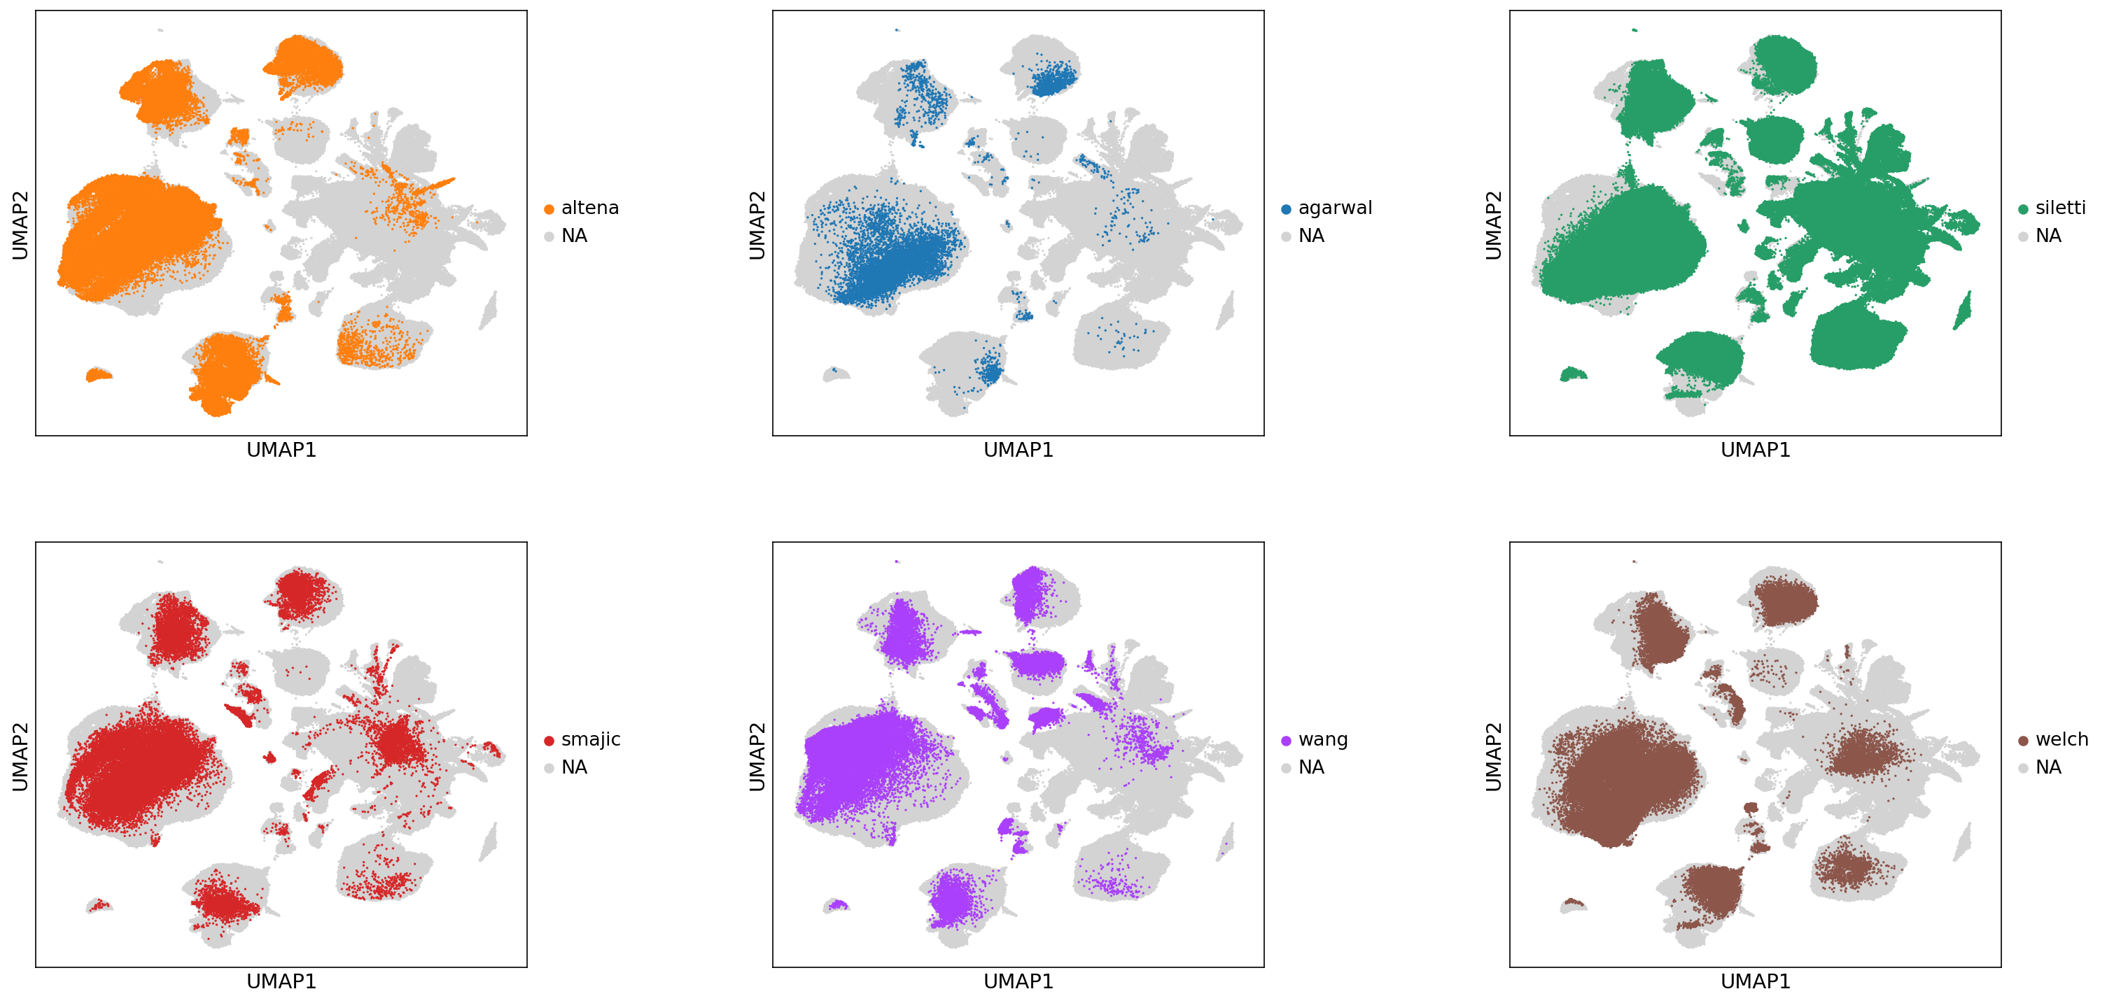
3.1 Final integration (Aim#1)
Hyperparameter values:
2000 HVGs
90 Latent features
5 Hidden layers
128 Hidden nodes

Slide 37
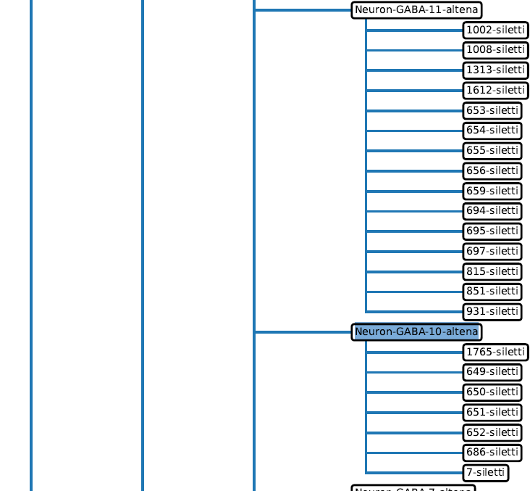
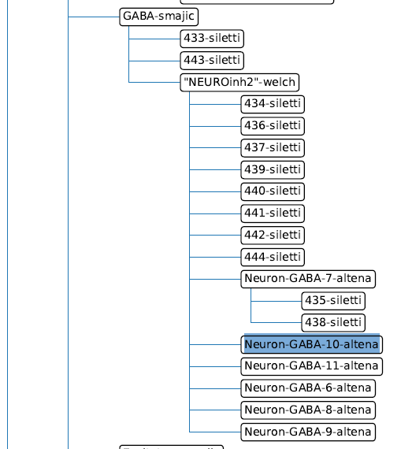
3.2 Neuron Hierarchy (Aim#2)
Integration of only neurons
Med resolution: highest level except for Siletti (still contained labels with many cells)
High resolution: highest level for all datasets
VS

Slide 38
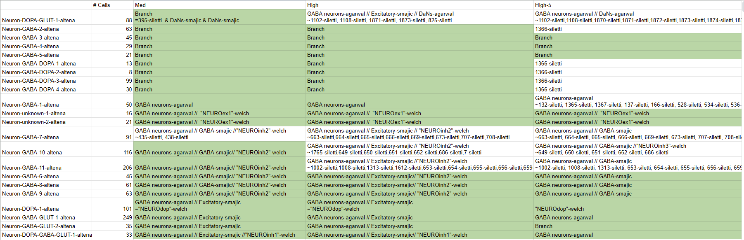
3.2 Neuron Hierarchy (Aim#2)
VTA-specific subtypes (van Regteren Altena)
Green: Leaf
//: branch path to Altena label
=: identical label, ~:sublabels

Slide 39
3.2 Neuron Hierarchy (Aim#2)
VTA-specific subtypes (van Regteren Altena)
Green: Leaf
//: branch path to Altena label
=: identical label, ~:sublabels

Slide 40
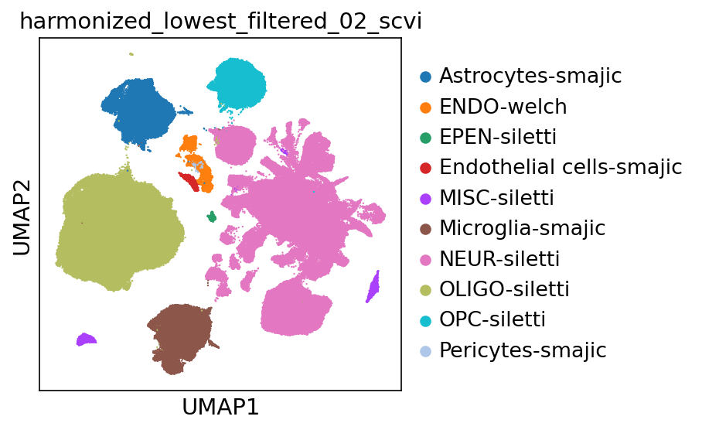
3.3 New cells (Aim#3)
Use Harmonized labels to train K-NN classifier
Including a threshold of 0.2 for unknown -> filter out
~520000 -> ~500000 cells

Slide 41
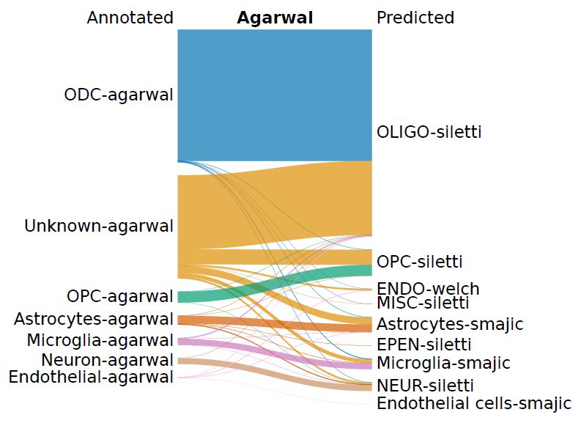
3.3 New cells (Aim#3)
Where do these cells come from?
New alignments (including intronic region mapping)
resulted in less filtered cells and reclassification

Slide 42
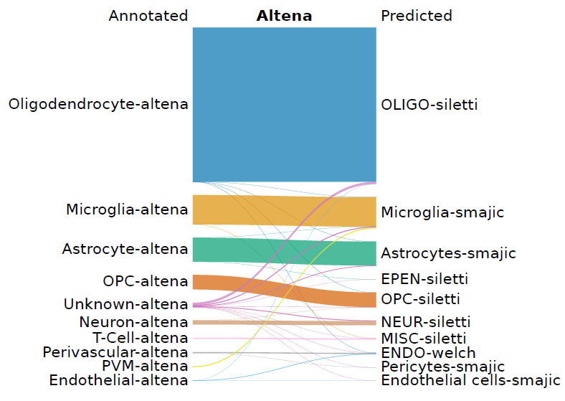
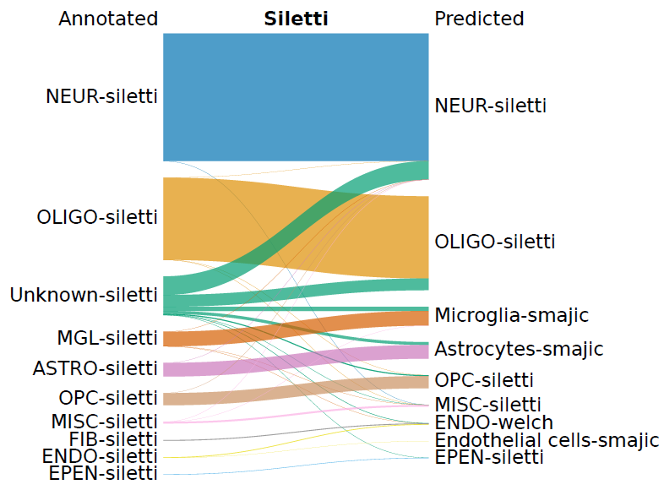
3.3 New cells (Aim#3)

Slide 43
?
4. What’s next?
Kamath et al. (2022) data access adds 184673 SNpc cells (~15684 healthy dopaminergic cells)
Pipeline can be used for the integration of other regions/ species datasets e.g. mouse (Onur Basak)
Inter-species comparison study of the midbrain (Onur Basak)
Mapping against reference atlas
Further characterization of subtypes e.g. locational information
Looked at neurons, but what about astrocytes, oligodendrocytes etc.?

Slide 44
Acknowledgements
Basak Lab
Onur Basak
Tiziana Hey
Abdool Al-Khaledi
Cecile Herbermann
Hol Lab
Anna van Regteren Altena
Others
Kimberly Siletti

Slide 45
Feedback
Don’t have enough time to go into detail.. instead of one black box there is many?
Processing
Integration
Label Harmonization
Benchmarking

